Slide 1
HEMODYNAMIC MONITORING
Dr.Sr. Philo Resmi .Vice Principal JMCON

Slide 2
Central OBJECTIVE
At the end of teaching students acquire knowledge about Haemo dynamic monitoring and able to explain and apply this knowledge while working in the educational and clinical set up.

Slide 3
Specific objectives
Explain the importance of hemodynamic monitoring.
List down Indications
Explain the Invasive and Non Invasive methods

Slide 4
INTRODUCTION
Hemodynamics refers to the dynamic movement of blood through the cardiovascular system.
It is the study of blood flow or the circulation

Slide 5
PURPOSES
Early detection, identification, and treatment of life-threatening conditions such as heart failure and cardiac tamponade.
Evaluate the patient’s immediate response to treatment such as drugs and mechanical support.
Evaluate the effectiveness of cardiovascular function such as cardiac output and cardiac index.

Slide 6
INDICATIONS
Decreased cardiac output
Eg.: Dehydration,Hemorrhage,G.I.Bleed, Burns, or Surgery)
All types of shock
Eg.: Cardiogenic, neurogenic, or anaphylactic.
Any deficit or loss of cardiac function
Eg.: Acute MI, CHF, Cardiomyopathy

Slide 7

TYPES OF MONITORING
INVASIVE
NON INVASIVE
Noninvasive BP
Skin Temperature
Heart Rate, pulses
SpO₂
Capillary Refill
ECG
ABG analysis
Central venous pressure (CVP).
Pulmonary artery pressure.
Intra arterial blood pressure.
Cardiac output (CO)

Slide 8
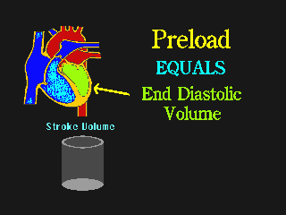

Hemodynamic terminologies
Stroke volume: the amount of blood leaving the left ventricle with each contraction
Cardiac output: the amount of blood leaving the left ventricle per minute.
Preload: is the volume of blood in the ventricle at the end of the diastole.
Afterload: is the pressure or resistance the ventricle must overcome to eject blood during diastole

Slide 9
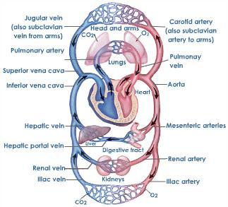

Slide 10
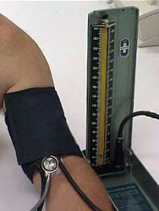
NON INVASIVE BP
Auscultatory method first proposed by Korotkoff.
BP is the pressure exerted by blood on the walls of arteries during ventricular systole & diastole.
The average normal BP is 120/80 mmHg.
FACTORS AFFECTING BP
Cardiac Output
Distension of arteries
Volume
Viscosity
Velocity of blood

Slide 11
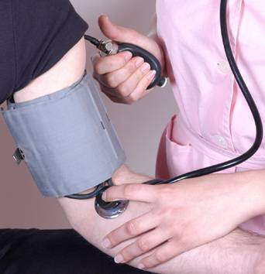
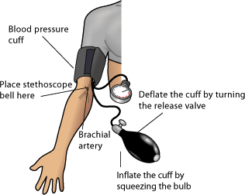
For each heartbeat, BP varies between systolic and diastolic pressures.
Systolic pressure is peak pressure in the arteries, which occurs near the end of the cardiac cycle when the ventricles are contracting.
Diastolic pressure is minimum pressure in the arteries, which occurs near the beginning of the cardiac cycle when the ventricles are filled with blood.

Slide 12
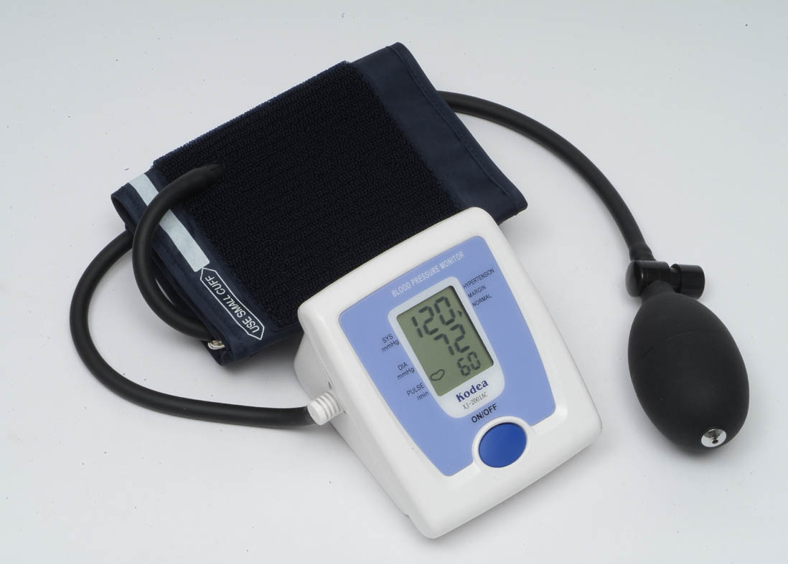
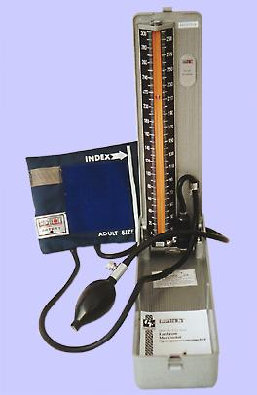
TYPES OF NIBP
Auscultatory method
  Sphygmomanometer
  Digital monitor
Oscillometric method
Palpatory method

Slide 13
TO ENSURE CORRECT BP
Cuff size must be appropriate for patient (bladder width atleast 40% & length atleast 80% of limb circumference)
Calibration of manometer should be done routinely to ensure accuracy of BP reading.
Positioning of cuff : no less than 2.5 cm from ante cubital fossa
Cuff is firmly wrapped around the arm & the cuff bladder is centered over the brachial artery.

Slide 14

PULSE RATE
Represents the tactile arterial palpation of the heartbeat.
The pulse may be palpated in any place that allows an artery to be compressed against a bone.
In most people, the pulse is an accurate measure of heart rate.
Under certain circumstances, including arrhythmias, some of the heart beats are ineffective, and the aorta is not stretched enough to create a palpable pressure wave.
The pulse is too irregular and the heart rate can be (much) higher than the pulse rate.

Slide 15
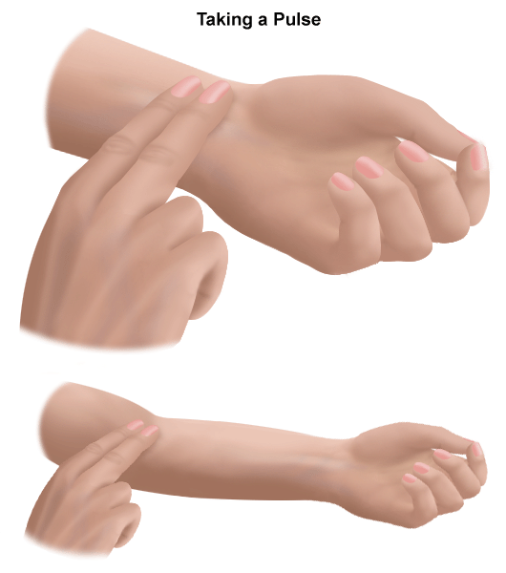
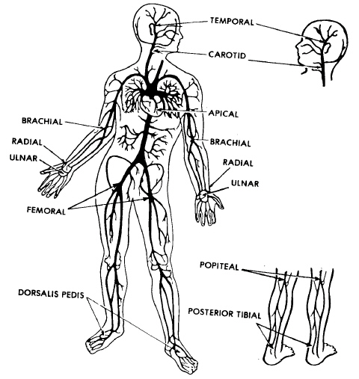
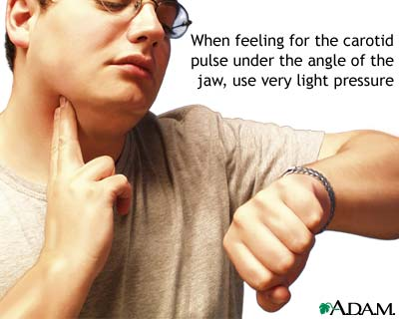
SITES TO CHECK PULSE RATE

Slide 16

HEART RATE
Heart rate is the number of heartbeats per unit of time -
HR can be obtained from ECG strip.
  Regular rhythm : Count number of small boxes within an RR & divide 1500 by that number.
  Irregular rhythm : count the number of RR intervals in 6 secs & multiply that number by 10.
Obtained by auscultating at the apex 4th ICS on left of sternum.
Also be obtained by placing a pulse oxymeter probe on fingertrip, earlobe, forehead, or bridge of nose.

Slide 17
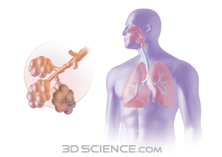
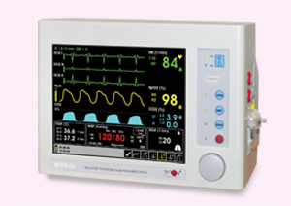
RESPIRATORY RATE
Respiratory Rate can be obtained by counting the chest movement during inspiratory phase & counted for 1 full minute.
It can also be obtained by placing a probe of pulse oxymetry & reading would be displayed on the monitor attached to it.

Slide 18
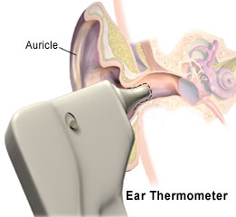
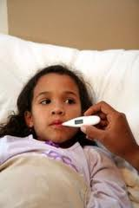
TEMPERATURE MONITORING. SITES
Axilla
Oral
Rectum
Tympanic membrane
Skin
Other sites
  Nasopharyngeal
  Esophageal
  Bladder

Slide 19
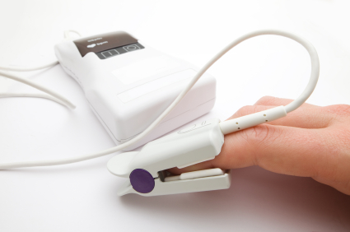
PULSE OXIMETRY
It is a non-invasive method of continuously monitoring the oxygen saturation of hemoglobin.
PRINCIPLES :
  Spectrophotometry – oxyhemoglobin and deoxyhemoglobin differ in their absorption of red and infra red light.
  Photoplethysmography-the volume of arterial blood in tissue and the light absorbed by blood changes during the pulse.
  Normal SpO2 = 90 -100 %

Slide 20
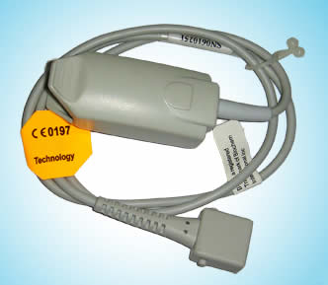
PULSE OXIMETRY
The principle of pulse oximetry is based on the red and infrared light absorption characteristics of oxygenated and deoxygenated hemoglobin.
Oxygenated hemoglobin absorbs more infrared light and allows more red light to pass through.
Deoxygenated (or reduced) hemoglobin absorbs more red light and allows more infrared light to pass through.

Slide 21
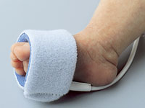
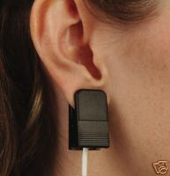
PULSE OXIMETRY PROBE
Probe attached to fingertip, earlobe, or bridge of nose.
SPO2 reading affected by :
  Motion of extremity
  Abnormal Haemoglobin
  Fingernail polish
  Abnormal skin pigmentation
  Anemia
  Shock
  Vasoconstricting medication
  Cardiac arrest

Slide 22
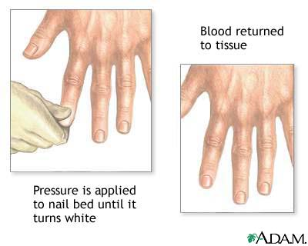
CAPILLARY REFILL TIME
Capillary refill is the rate at which blood refills empty capillaries.
Measured by holding a hand higher than heart-level (prevents venous reflux), pressing the soft pad of a finger or toe until it turns white, and taking note of the time needed for colour to return once pressure is released.
Normal refill time is less than 2 seconds.

Slide 23
CAPILLARY REFILL TIME
In neonates, capillary refill can be measured by pressing on the sternum for five seconds with a finger or thumb.
The upper normal limit for capillary refill in neonates is 3 seconds.
A common measure of dehydration and peripheral perfusion.
It is useful as supporting evidence for a positive sign of poor perfusion to the extremities.

Slide 24
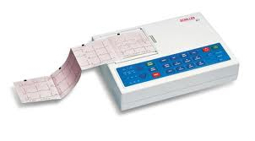
ELECTROCARDIOGRAM

Slide 25
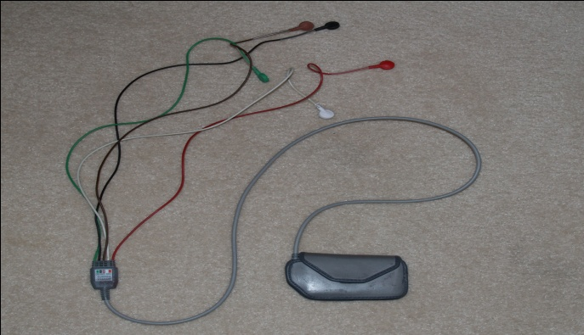
An ECG is a permanent record of the electrical impulses generated in the heart by the depolarization.
These impulses are transmitted on the surface of the body where they are detected & picked up by electrodes & recorded as a tracing on a special graph paper.
It is a diagnostic tool in assessing the cardiovascular system.

Slide 26
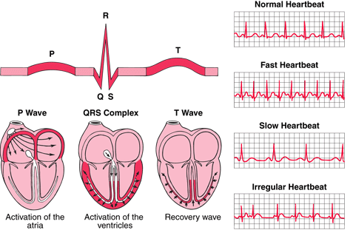
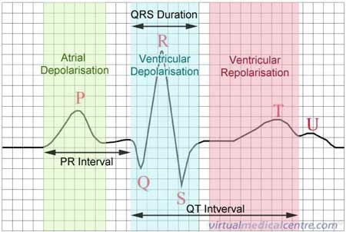

Slide 27
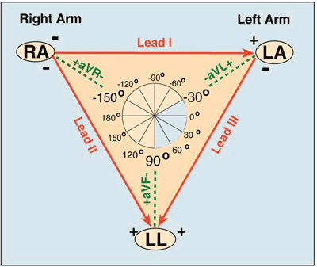
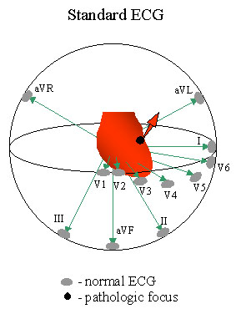

Slide 28
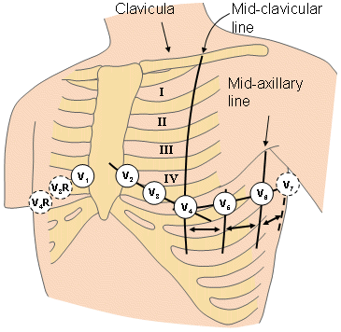
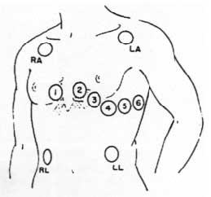

Slide 29
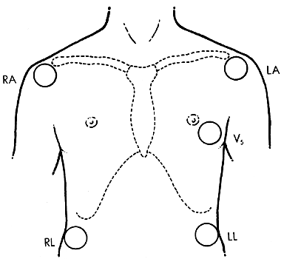
FIVE-ELECTRODE SYSTEM
The use of five electrodes allows the recording of the six standard limb leads (I, II, III, aVR, aVL, aVF), as well as one precordial unipolar lead.
Generally, the unipolar lead is placed in the V₅ position, along the anterior axillary line in the fifth intercostal space .
This allows one to monitor several areas of the myocardium for ischemia or to establish a differential diagnosis between atrial and ventricular arrhythmias.

Slide 30
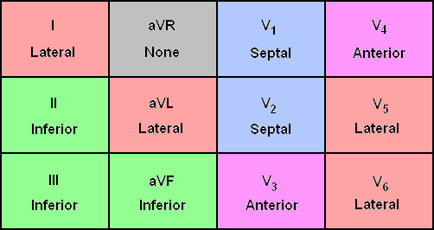

Slide 31
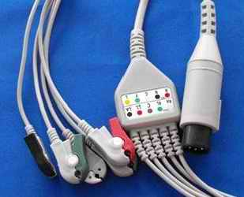
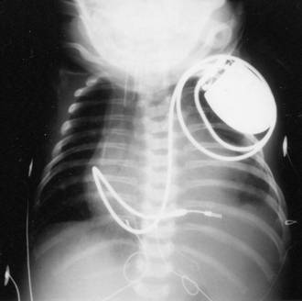
TYPES OF LEADS
Surface leads
Esophageal leads
Epicardial leads
Intra cardiac leads

Slide 32
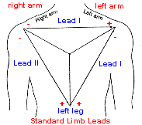
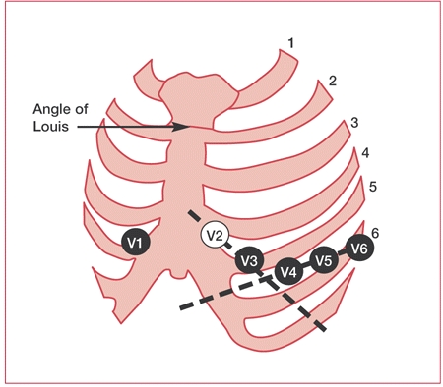
SURFACE LEADS
The standard lead system
  3 bipolar limb leads-I,II,III
  3 unipolar limb leads-aVR,aVL,aVF(augmented limb leads)
  6 standard chest leads or precordial leads(V1 to V6)

Slide 33
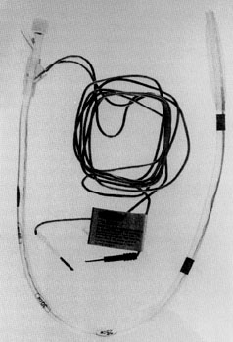
ESOPHAGEAL LEADS
The esophageal electrodes are incorporated into an esophageal stethoscope and are welded to conventional ECG wires
One passed into the esophagus with the tip positioned at the level of the heart. It provides an excellent means of monitoring heart sounds and respiration
Often the P wave is not detected or the relationship of the P wave to the QRS complex is unclear on surface leads.
P waves are much larger in esophageal due to the proximity of esophagus to right atrium.
Care must be taken to avoid esophageal burns.

Slide 34
EPICARDIAL LEADS
Temporary transcutaneous pacing wires sutured to the atrium and ventricle.
Allow monitoring of electrical activity directly from the surface of heart.
Helps in detecting atrial activity in situations in which the surface ECG fails to detect P waves.
Ventricular epicardial electrograms are of little value because QRS complex is readily detected on surface ECG.

Slide 35
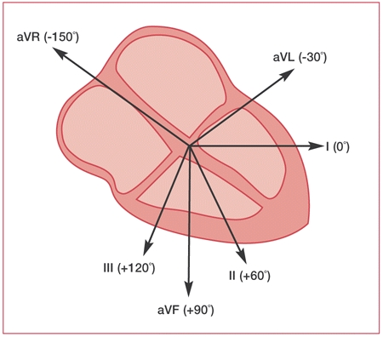
RISKS OF ECG MONITORING
Electrical shock injury
Burns
Artifacts
Institution of inappropriate therapy due to misdiagnosis of arrythmias

Slide 36
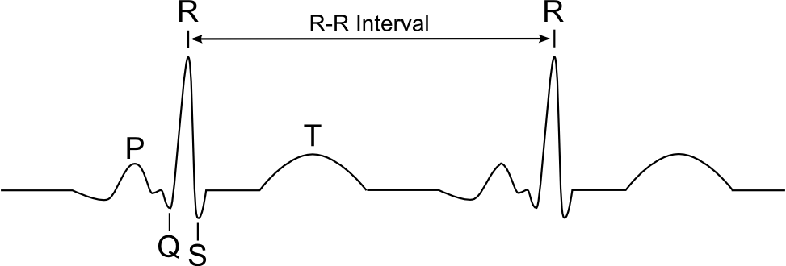
ABNORMAL ECG
P WAVE :Abnormal or absence of P wave indicates that an area other than SA Node is acting as a pacemaker.
PR INTERVAL :Prolonged PR interval indicates conduction block.
QRS COMPLEX :Prolonged QRS complex indicates abnormal sequence of conduction through the ventricles.
ST SEGMENT :Elevation or depression represents ischemia or infarction.
T WAVE :Flat T wave indicates ischemia, inverted T wave indicates Myocardial Infarction, spiky T wave indicates hyperkalemia.

Slide 37
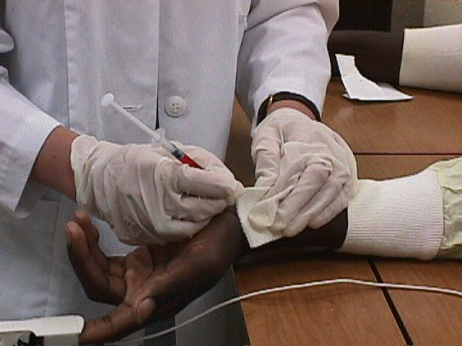
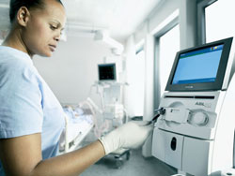
ABG ANALYSIS

Slide 38
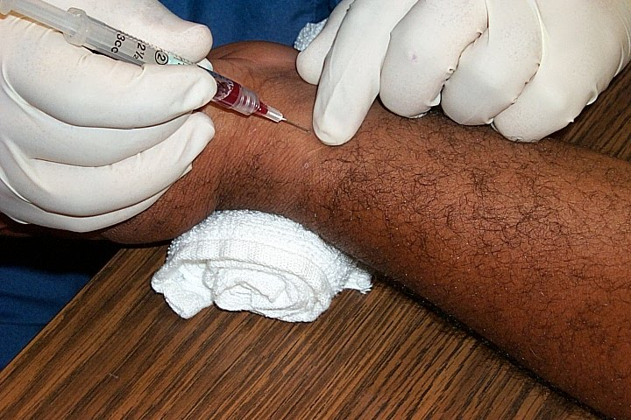
ABG ANALYSIS
The procedure involves obtaining
arterial blood from a direct arterial puncture or from an arterial line.
NORMAL VALUES :
  PaO₂ : 80-100 mm Hg
  SaO₂ : 93 – 100%
  pH : 7.35 – 7.45
  PaCO₂ : 35 – 45 mm Hg
  HCO₃ : 22 – 26 mEq/L

Slide 39
EVALUATING ABG
If pH < 7.35, Acidemia
If pH > 7.45 , Alkalemia
If PaCO2 < 35 mmHg ,Respiratory Alkalosis
If PaCO2 > 45 mmHg , Respiratory Acidosis
If HCO3 < 22 mEq /L, Metabolic Acidosis
If HCO3 >26 mEq/L, Metabolic Alkalosis

Slide 40
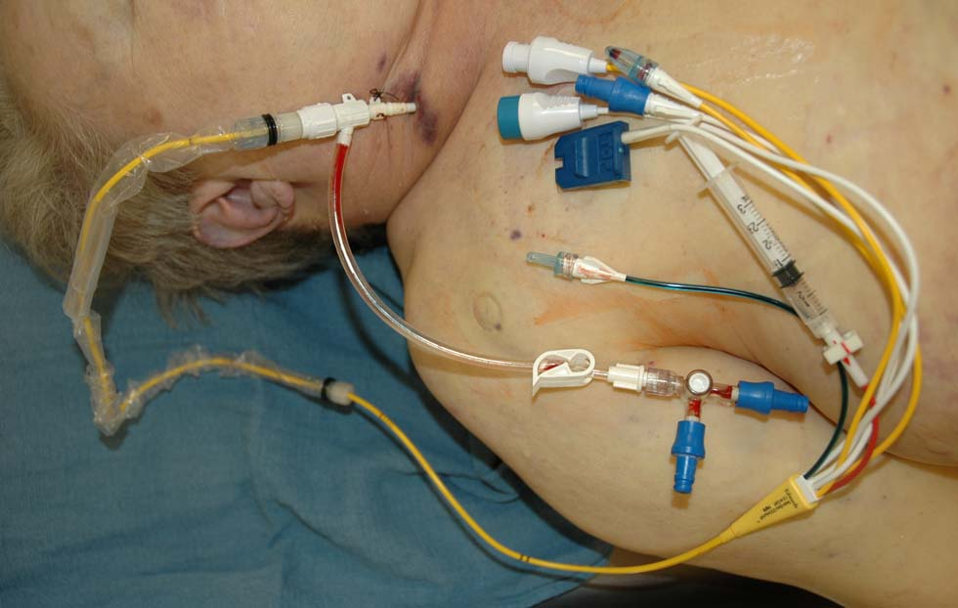
INVASIVE METHODS
SWAN GANZ CATHETER

Slide 41
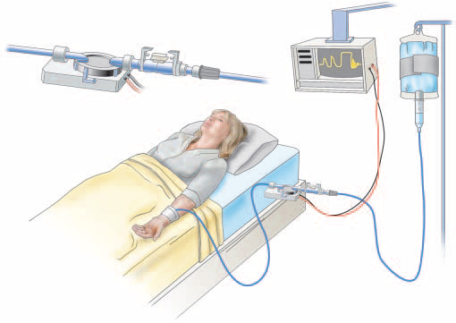
Invasive Hemodynamic Monitoring System
Transducer
Monitor
Flush
Catheter

Slide 42
Hemodynamic monitoring system
MONITOR
  scale
FLUSH SYSTEM
  Heparin vs non heparenized
  Pressure bag
TRANSDUCER
  Disposable vs reusable
CATHETER
  Pressure lines
  Invasive lines

Slide 43
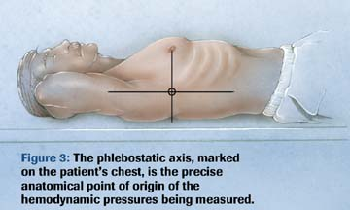
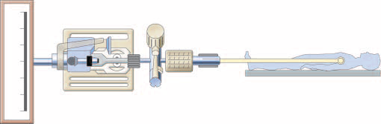
Steps of hemodynamic monitoring
Flushing
Levelling
Zeroing
Square wave test

Slide 44
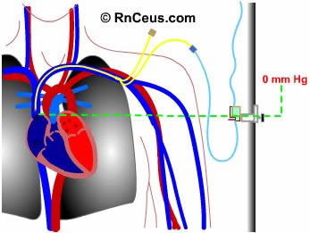
INVASIVE METHODS
Central Venous Pressure Monitoring
Intra Arterial BP Monitoring
Pulmonary Arterial Pressure Monitoring
Cardiac Output

Slide 45
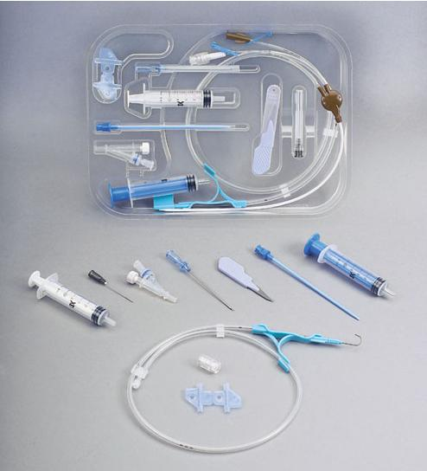
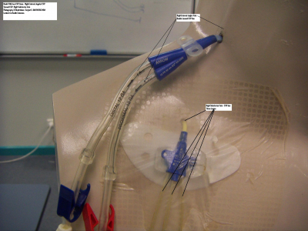
C
V
P
m
o
n
i
t
o
r
i
n
g

Slide 46
CENTRAL VENOUS PRESSURE MONITORING
Refers to the pressure of blood in the RA or vena cava.
Purpose
It serve as a guide to fluid balance in critically ill patients
Estimate the circulating blood volume
Assist in monitoring circulatory failure

Slide 47
Indications for inserting central lines
  Fluid resuscitation
  Parenteral feeding
  Measurement of central venous pressure
  Poor venous access
  Administration of irritant drugs

Slide 48
Common central line insertion sites
Internal jugular vein
Subclavian vein
Femoral (as a last resort)
Peripherally inserted central catheters (PICC)

Slide 49
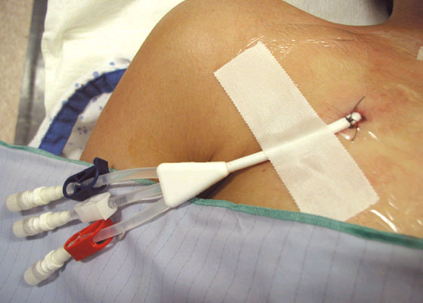
TYPES OF CENTRAL LINE
Single lumen
Triple lumen
Quadruple lumen

Slide 50
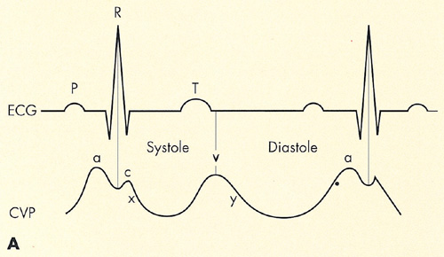
THE CVP WAVEFORM
  a wave: rise in pressure due to atrial contraction
  x decent: fall in pressure due to atrial relaxation
  c wave: rise in pressure due to ventricular contraction and closure of the tricuspid valve
  v wave: rise in pressure during atrial filling
  y decent: fall in pressure due to opening of the tricuspid valve and onset of ventricular filling

Slide 51
INTERPRETATION OF RESULTS
Normal CVP 2-8 mmHg
Situations which increases CVP
  CHF
  Cardiac tamponade
  Hypovolemic state
  Hypervolemia
  Tricuspid valve disease
Situations which decreases CVP
  Drug-induced vasodilatation

Slide 52
Nursing care
Anxiety
Imbalance Fluid Volume
Ineffective Health Maintenance
Risk for Injury
Deficient Knowledge
Risk for Infection

Slide 53
Complications
Malposition of the catheter
Haematoma
Arterial puncture
Pneumothorax
Haemorrhage
Sepsis
Air embolism
Thrombosis
Haemothorax
Cardiac tamponade
Cardiac arrhythmias

Slide 54
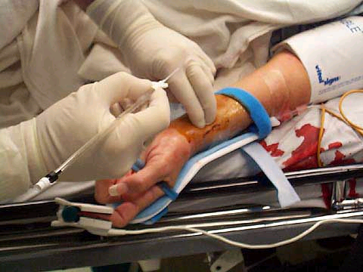
INTRA ARTERIAL BP
Intra arterial pressure monitoring of blood pressure gives an accurate value of blood pressure.
In normal conditions pressure obtained by intra arterial catheter is about 2-8 mm Hg greater than cuff measured pressure.

Slide 55
INTRA ARTERIAL BP
Most common sites for arterial catheter insertions are radial, brachial, femoral, or dorsalis pedis arteries.
Artery selection
  Size of the artery in relation to size of catheter
  Accessibility
  Free from contamination by body secretions
  Adequate collateral flow

Slide 56
SITES FOR CANNULATION
Radial artery
Brachial artery
Femoral artery
Dorsalis pedis artery
Superficial temporal artery
Umbilical artery
Ulnar artery

Slide 57
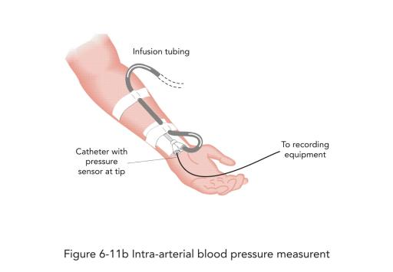
INDICATIONS FOR IABP
Continuously receiving IV vasoactive drugs
Need frequent arterial blood sampling
Need for rapid removal of blood (phlebotomy)
Low-flow states (shock) or hypotensive
Have severe vasoconstrictive or vasodilation problems

Slide 58
CATHETER INSERTION
Seldinger technique: catheter is inserted over the guide wire
Patient on a tilting bed, trolley or operating table
Sterile pack and antiseptic solution
Local anaesthetic
Appropriate catheter size
Syringes and needles

Slide 59
CATHETER INSERTION
Saline or heparinised saline to prime and flush the line after insertion
Suture material
Sterile dressing
Shaving equipment for the area if very hairy
A 3-way stopcock, sterile saline, a fluid administration set

Slide 60

NORMAL VALUES
Systolic pressure – 90 to 140 mmHg
Diastolic pressure – 60 to 90 mm Hg
Mean Arterial Pressure = SBP + 2(DBP)
3
It is 70 -105 mm Hg

Slide 61

MONITORING DEVICE
  Transducer
  Disposable transducer with 3 way stop cock
  Means of displaying and recording information

Slide 62


Slide 63

INTRA ARTERIAL BP MONITORING

Slide 64
PHLEBOSTATIC AXIS
Intersection of the midaxillary and a line drawn from the fourth intercostal space at the right side of the sternum

Slide 65
ZEROING
During zeroing, the system is closed only to the patient’s pressure. All other sources of pressure (which cannot be removed) remain exerted against the transducer(eg: atmospheric, flush device). The monitor is then told to call this pressure “ZERO”.

Slide 66
SIGNIFICANCE OF ZEROING
For every 1 cm the air-fluid interface is above or below the actual level of the left atrium, 0.74 mm Hg of hydrostatic pressure is subtracted or added to the measured pressure.
If the air-fluid interface is placed 10 cm below the phlebostatic axis, the measured pressure will be an overestimation of the actual hemodynamic pressure by 7.4 mm Hg.

Slide 67

PROCEDURE
Eliminate all air bubbles
Place the transducer at the phlebostatic axis
To ‘zero’ the system adjust the stopcock nearest to the transducer off to the patient, open to air
Press monitor and adjust the appropriate value
Now open the transducer to the patient, closed to air and continuous pressure monitoring can begin.

Slide 68


ARTERIAL WAVE FORM
The arterial waveform reflects
the pressure generated in the
arteries following ventricular
contraction and can be
described as having:-
  Anacrotic notch
  Peak systolic pressure
  Dicrotic notch
  Diastolic pressure

Slide 69


Slide 70

COMPLICATIONS
INFECTION
Assess insertion site frequently
Sterile dressing changes, tubing changes, and flush solution should be done as per institutional policy
Blood or air in the system should be removed by aspirating through the stopcocks
Sterile caps may be used to cover the stopcock ports between use

Slide 71

COMPLICATIONS
THROMBOSIS
Flushing with heparinised saline
EMBOLISM
Keep the system air tight
Remove air from tubing

Slide 72

COMPLICATIONS
Accidental blood loss
All connections should be fastened securely
Extremity should be immobilized and visible
Assure that the alarm system remains activated
and the limits are appropriately set
Accidental intra arterial injection of drugs
Dislodging / disconnection
Damage to nerves

Slide 73

COMPLICATIONS
Impaired circulation to extremity
Monitor the circulation in the extremity continually
Color, sensation, and movement should be assessed initially after insertion of the catheter and at least 8hrly as long as the catheter is in place

Slide 74
NURSING MANAGEMENT
Before obtaining readings make sure that the transducer is placed at zero reference point
The quality of waveform should also be evaluated before taking readings
The system should be zeroed and calibrated at least every 8 hrs
The values should also be compared to auscultated cuff pressure every 8hrly and whenever accuracy is questioned.

Slide 75
NURSING MANAGEMENT
Use sterile technique for catheter insertion
Cleanse the skin site with appropriate antiseptic solution
Replace dressings when damp,loosened, or soiled.
If local cutaneous infection is present at the skin puncture site,remove the catheter.
If catheter related infection is suspected,replace the catheter.
Do not use arterial catheters for routine blood sampling that do not require arterial blood.

Slide 76
NURSING MANAGEMENT
Use disposable,rather than reusable transducer assemblies with closed,continuous flush systems whenever possible.
Treat stopcocks as a sterile field and keep covered with a cap or syringe when not in use.
If persistent bacteremia occurs while an arterial catheter is in place,remove the catheter 24 to 48 hours from the time antimicrobial therapy has been started.

Slide 77
REMOVAL OF ARTERIAL LINE
This is an aseptic procedure
Remember universal precautions
The procedure should be explained to the patient
Take dressing off line
Remove arterial line ensuring that the entry site is covered with gauze
Apply digital pressure for at least 5 minutes to ensure haemostasis
Dress site with gauze and micropore
Assess the peripheral circulation as thrombosis can occur after removal

Slide 78
PULMONARY ARTERY PRESSURE MONITORING

Slide 79
Pulmonary Artery pressure monitoring
Most commonly used PA flow directed catheter is Swan-Ganz catheter.
Proximal port – [Blue] terminate in RA,used to measure central venous pressure/RAP & CO
Distal port – [Yellow] terminate in PA, used to measure pulmonary artery pressure
Balloon port – [Red] used to inflate & deflate balloon
Thermistor port– [White] measure core body temperature

Slide 80
PULMONARY ARTERY PRESSURE MONITORING
Most commonly used PA flow directed catheter is Swan-Ganz catheter.
Proximal port – [Blue] terminate in RA,used to measure central venous pressure/RAP & CO
Distal port – [Yellow] terminate in PA, used to measure pulmonary artery pressure
Balloon port – [Red] used to inflate & deflate balloon
Thermistor port– [White] measure core body temperature

Slide 81


Slide 82
INDICATIONS
Cardiac surgery
Poor LV function (EF<0.4; LVEDP> 18 mmHg)
Recent MI
Complications of MI eg. MR, VSD,
ventricular aneurysm.
Combined lesions eg. CAD+MR or CAD+AS

Slide 83

INSERTION
Left or right subclavian vein
Internal or external jugular vein
Femoral veins
NORMAL VALUES
PA systolic : 20-30 mmHg
PA diastolic : 8-15 mmHg
PA mean : 10 -20 mmHg
PCWP : 8-12 mmHg

Slide 84
PULMONARY CAPILLARY
WEDGE PRESSURE (PCWP)
The pulmonary artery wedge pressure is the measure of the filling pressure in the left side of the heart
Indirect measurement of left ventricular end diastolic pressure
PA balloon is advanced & floated through the RA → tricuspid valve → RV → the pulmonic valve → Pulmonic Artery → the wedged position
Record a continuous strip of the insertion hemodynamic waveforms at the bedside

Slide 85
PCWP
Inflation of the balloon at the tip of pulmonary artery catheter creates a static column of blood between the catheter tip and the left atrium.
In this situation the pressure at the tip of the pulmonary artery catheter is the same as the pressure in the left atrium.
Left atrial pressure is the same as the LV end diastolic pressure (LVEDP)
Therefore PCWP can be used as a measure of left ventricular filling pressure.
Notes:
the LV end diastolic pressure (LVEDP)

Slide 86


Slide 87

PCWP

Slide 88
NURSING MANAGEMENT
Secure & assess the position
  Forward – indicated by PCWP pressure tracing
  without the balloon being inflated
  Backward – presence of RV tracing
Proper technique must always be followed when the
balloon is inflated to obtain a PCWP
  Overinflation – PA rupture
  Prolonged inflation – Pulmonary infarction
Inflation of the balloon should be done slowly
  Change from PA wave form to PCWP wave form
Slight resistance should be felt, when balloon is being
inflated.

Slide 89
COMPLICATIONS
Pulmonary artery rupture
Air embolism
Pulmonary thromboembolism
Ventricular dysrhythmias
Pulmonary artery infarction
Valvular damage
Balloon rupture

Slide 90

CARDIAC OUTPUT
Amount of blood pumped out of the left ventricle into the systemic circulation every minute.

Slide 91
METHOD : FICK METHOD
Assumes that the rate at which oxygen is consumed is a function of the rate of blood flows and the rate of oxygen picked up by the red blood cells.
The Fick principle involves calculating the oxygen consumed over a given period of time from measurement of the oxygen concentration of the venous blood and the arterial blood.
It uses the difference between arterial & venous oxygenation, Oxygen consumption & CO2 production to determine CO.

Slide 92
THERMO DILUTION
Some iced or room temperature solution is rapidly injected into the RA port. The cool injectate mixes with blood in the RA, dropping the mixed blood temperature.
Change in temp is detected by thermistor bead at the distal end of the catheter in the PA and recorded as time-temp curve in the monitor.
Based on this curve,cardiac output is calculated by the computer.

Slide 93

A plot of temperature change DT versus time is the thermodilution curve (graph above). Cardiac output is inversely proportional to the area under the thermodilution curve (with a large cardiac output, the bolus is pumped rapidly past the thermistor, and so the area is small

Slide 95
INTERPRETATION OF RESULTS
CO - 4 – 8 L/min
CI - 2.5 – 4 L/min/m²
Eg: Cardiogenic shock
Low CO & CI, High PCWP & PA diastolic pressure

Slide 96
Hemodynamic Parameters | Abbreviations | Normal Values
Mean Arterial Pressure | MAP | 70-90 mm Hg
Right Atrial Pressure | RAP | 2-6 mm Hg
Central Venous Pressure | CVP | 2-8 mm Hg
Pulmonary Artery Systolic Pressure | PAS | 20-30 mm Hg
Pulmonary Artery Diastolic Pressure | PAD | 6-12 mm Hg
Pulmonary Artery Mean Pressure | PAM | 10-15 mm Hg
Pulmonary Artery Wedge Pressure | PAWP, Wedge | 8-12 mm Hg
Cardiac Output | CO | 4-8 L/min
Cardiac Index | CI | 2.5-4 L/min
Stroke Volume | SV | 60-130 ml
Stroke Volume Index | SVI | 40-50 ml/m2
Systemic Vascular Resistance | SVR | 800-1200 dynes

Slide 97
NURSING MANAGEMENT
Eliminate as many potential sources of error as possible
Procedure should be done at a time when the patient is in a quiet, steady state
Each cardiac output measurement should be obtained in the same position

Slide 98
ELECTRICAL SAFETY
The patient should be in a nonelectric bed. If an electric bed must be used, it should be unplugged from the wall outlet or properly grounded
Bed linens should be changed immediately when wet

Slide 99
NURSING MANAGEMENT
Eliminate as many potential sources of error as possible.
Procedure should be done at a time when the patient is in a quiet, steady state.
Each cardiac output measurement should be obtained in the same position.

Slide 100
ELECTRICAL SAFETY
The patient should be in a nonelectric bed. If an electric bed must be used, it should be unplugged from the wall outlet or properly grounded.
Bed linens should be changed immediately when wet.
The CO computer cable should be
inspected for continuity before use.
The computer and the cable should be kept dry and clean.

Slide 101
SUMMARY
Hemodynamics
Hemodynamic monitoring
Types
Purpose
Indication
Noninvasive measurements
Arterial pressure monitoring
PA pressure monitoring
Cardiac output

Slide 102
REFERENCES
Cecelia.g.a.et al; nursing procedures; 3rd edition.
Smeltzer.s.c;bare.g.b;brunner and sudharths text book of medical surgical nursing ; 10th edition ; Lippincott Williams and Wilkins company.
Braunwald.e;etal;harrisons principles of internal medicine;15th edition.
www.wikepedia.org

Slide 103
THANK YOU

