Slide 1
COURSE | : B.Sc Nursing IV Year
SUBJECT | : Community Health Nursing II
UNIT | : IV
TOPIC | :Job description of community health nursing personnel
PREPARED BY | :Seeja Jacob, Department of community health nursing
11

Slide 2
LEARNING OBJECTIVES
The students will be able to:
define community health nursing
mention various community personnel
health nursing
state the various job functions of health workers
discuss job description of community health nurse
describe responsibilities of ANMs, AWWs and ASHAs
explain the roles and responsibilities of Health Assistants
22

Slide 3
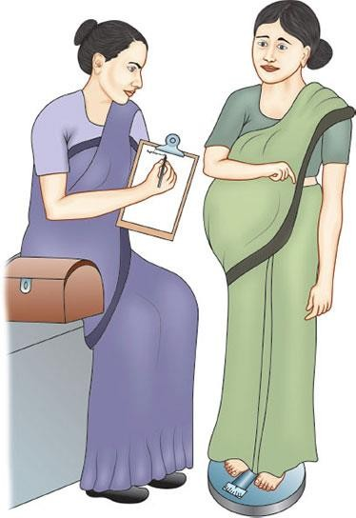

1. INTRODUCTION

Slide 4
2. DEFINITION
Community Health Nursing is the synthesis of nursing and public health practice applied to promote and protect the health of population. It combines all the basic elements of professional, clinical nursing with public health and community practice

Slide 5
COMMUNITY HEALTH NURSING TEAM
DPHN
CHN/PHNO
FHA
MHA
FHW(3)
MHW(3)
DAI
VHG
ASHA
VHG
ASHA

Slide 6
DISTRICT PUBLIC HEALTH NURSE (DPHN)
DPHN is responsible for looking after the work of all nursing staff employed in the district, in most of the states, appointed on this post is made on the basis of merit cum seniority

Slide 7
Administrator or managerial function
Responsible for efficient implementation of policies and programmes related to nursing in district.
Nursing administration (selection, recruitment, promotion,leave, inservice training etc,)sending recommendations related to the above mentioned tasks to the districts medical officer .
Participation in preparing budget for nursing service,material and equipment
Forwarding annual reports, work reports etc received from nursing personnals
Evaluate the work of nursing personnals /health workers

Slide 8
Will make recommendation to district health officer on requirements of nursing staffs in primary health fields
The DPHN is responsible for planning, organizing ,directing the public health programmes
Participates in policy-making activities in regards to health care
She is directly responsible to the District health office and delegates the responsibility to all nursing personnel in the district community health field. i.e., PHC,SC,FP and all national health programmes

Slide 9
Supervisory function
Conduct regular meeting and solving officials as well as personal problems in best possible way.
Supervising the work of nursing personal from time to time
Maintain discipline among the health members.
Taking disciplinary action
Encouraging the qualities of co-operation and co-ordination among nursing personal
Improving the standard of patient care in the hospital
Field visit at least four times a month to supervise each staff member in sub centres and PHCs and ensure the quality care
Evaluation of nursing service . She plans for continuously improving the quality of client care

Slide 10
Encourage, initiative and help in promoting professional growth of staffs
Interpretation of policies, plans and rules to the staffs so as to regulate and develop the services
Advice on organising and planning of work, helping the individuals staffs member to evaluate the needs of their particular areas and to select priority of her work.
Guidance of staffs regarding use of records, reports and on collection of statistical data and record keeping system.

Slide 11
Educational function
Organise the in-services education programme for all nursing staffs.
Observation of nursing educational instructions (GNM/ANM or FHW) of the district from time to time
Improving the standards of nursing students and nursing education
Initiate and assist in planning and organising the orientation programme for new staffs.
Participate in community health field organised for nursing students of schools or college of nursing and suggest in selection of areas for practical experience.
Provide facilities and resources to students and staffs and guide them during field experience
Making programe for the Dai (TBAS) training and training of nursing staff

Slide 12
Other functions
Organising nursing workshop, seminars,discussion etc
Participation at state level, as a nursing representatives of district
Encouraging nursing researches
Getting co-operation from other institution/organizations to improve the quality of nursing service

Slide 13
PUBLIC HEALTH NURSE OFFICER( PHNO)
PHN Supervisor, guides and supervise ,the function of public health nurse, health workers, working in her assigned field.
she is responsible to DPHN for provision of supervision and improvement of community health care

Slide 14
Roles
Providing leadership in the planning of total health care to all individuals, families and community in the assigned area
Carryout preventive ,promotive, curative and rehabilitative care
Assisting the development of the standard of health care with accepted philosophy, objectives and health policies
Assisting the preparation of budget for community health department
Utilizing the budget allotted to department (community health)
Supervise and guidance of PHN/LHV/FHW/MHW working in her field
Organising educational programme for community members including school children, RCH group, or other target group in her area
Supervision of records /reports prepared health workers ,working under her jurisdiction
Assisting DPHN for the preparation of job description and assigned responsibilities for other community health worker

Slide 15
HEALTH WORKER-(FEMALE) ANM/JPHN
She is designated as multi purpose health worker(MPHW (F) ,she has the responsibility to deliver MCH sevices in the rural area. She is posted in subcentre to cover the population of about 5000 in plain areas and 3000 in hilly areas,
She will carry out the following functions:
Maternal and Child Health:
1.Record keeping- antenatal register, post natal register, underfive register, clinic attendance register, eligible couple register, home visiting register, birth and death register, family planning register
Register and provide care to pregnant women throughout the period of pregnancy
2. antenatal care at home, care at clinic
Ensure the Antenatal checkups and visits
Estimate haemoglobin level and urine sugar and albumin of pregnant women

Slide 16
Refer cases of abnormal pregnancy or gynaecological problems to the PHCs
3. Intranatal care
Conduct and supervise deliveries in the institution
4. postnatal care
At least 3-5 visits after delivery
5. Family planning:
-Utilise the information from the Eligible couple and child register for Family Planning programme
- Spread the message of family planning to the couples and motivate them
6. Care of infants
Arrange primary immunization programm

Slide 17
Medical Termination of Pregnancy:
Identify the women requiring help of MTP and refer them to nearest approved institution
Educate the community of the consequences of septic abortion and inform them about the availability of services for MTP.
Nutrition:
Identify cases of malnutrition among infants and young children, give the necessary treatment and advice and refer serious cases to PHC

Slide 18
Distribute IFA as prescribed to pregnant women, nursing mothers and young children as per guidelines
Administer Vitamin -A Solution to children as per guidelines
Educate the community about nutritious diet for mothers and children
Co-ordinate with Anganwadi workers

Slide 19
Universal Programme on Immunization:
Immunize pregnant women with TT
Administer DPT and other vaccines and ensures injection safety.
Dais training:
List Dais in her area and involve them in promoting Family welfare
Help the Health Assistant/LHV in the training programme on Dais

Slide 20
Communicable Diseases notification
Notify the communicable diseases and any increases or outbreak of any infectious diseases and report to PHC.
Vital events:
Record and report the vital events including births, deaths, in her area and maintenance of all the relevant records

Slide 21
Record keeping: Maintain prenatal and maternity records and child care records, eligible couple records, etc
Treatment of minor ailments:
Provide treatment for minor ailments, provide first aid for accidents and emergencies and refer cases to PHC/CHC/or nearest hospital.
Co-ordinate with the team workers and participate as a member of the team in camps and campaigns.
Health education
Implementation of health programmes

Slide 22
HEALTH WORKER( MALE)-JHI
Under the multipurpose scheme,one health worker male are posted in each sub centre expected to cover the population of 5000,(3000 in tribal and hilly areas)
Record Keeping:
He will survey all the families in his area and collect general information about each village/locality in his area
Prepare, maintain and utilize family records and village registers containing all the necessary details.

Slide 23
Vector Borne diseases:
Identify Malaria, Filaria, Japanese Encephalities and kala-azar endemic areas and follow up on drug administration.
Communicable Diseases:
Identify the communicable and infectious diseases and reports to PHC Medical officer immediately and educate the community about the importance of control and prevention against these diseases.

Slide 24
Leprosy and Tuberculosis:
Identify the cases of skin patches, especially if accompanied by loss of sensation and refer these cases.
Identify the person with prolonged cough or spitting of blood and take sputum smears for further investigations
Check whether all cases of tuberculosis are taking regular DOTS therapy

Slide 25
Environmental sanitation:
Educate community on the method of disposal of liquid and solid wastes, home sanitation,etc
Chlorinate public water sources including wells at regular intervals
EPI and Family Planning:
Administer vaccines and assist the health worker and also assist the health assistant in the school immunization programme.

Slide 26
Spread the message of family planning to the couples and motivate them for family plannig individually and groups.
Provide follow up services to male planning acceptors
Establish male depot holders in the area.
Health and family education
Vital events
Nutrition
Reproductive and child health programme
family

Slide 27
HEALTH ASSISTANTS (FEMALE)- LHV
Under the multipurpose workers scheme,a health assistant female is expected to cover a population of 30,000 (20,000 in tribal area,and hilly area)in which there are six sub centres, each with health worker female. The health assistant female will carry out following duties

Slide 28
1.Supervise and guidance
-health worker female,Dais, and guide ASHA in the delivery of health care service to the community
-Help the health worker female in improving the skills for working in the community,in planning and organizing the programme
-visit each subcentre atleast once a week on a fixed days
2. Team work
Help the health workers to work as a part of health team
Conduct regular staff meeting with the health workers in co-ordination with health assistant (male)
Assist MO of PHC in the organization of the different health services in the areas
Co-ordinate the health activities in her area with other department and agencies

Slide 29
3. Supplies ,equipment and maintains of sub Centre
-check at regular intervals the stores available at a subcentre and help in procurement of supplies and equipments
-Check that drugs at the subcentre are properly stored and equipment is well maintained
-ensure that health worker female maintains her general kit,midwifery kit and dai kit in the properway
4. Record and report
Scrutinise the maintenance od f records by HW(F) and guide her in their proper maintance
Review report received from the Health worker female
Consolidate and submit monthly report to the medical officer at PHC
5.Training
organize and conduct training for dais,ASHA
Assist the medical officer of PHC in conducting training programmes

Slide 30
6. Maternal and child health
7.Family planning and MTP
8. Nutrition
9.Universal immunization programme
10.Acute respiratory infection
11.School health
12.primary medical care
13.Health education

Slide 31
SPECIFIC JOB FUNCTIONS FOR THE FEMALE HEALTH ASSISTANT:
Carry out supervisory house visiting
Conduct MCH and family planning clinics and carry out educational activities
Organizes and conduct training for dais and women leaders with the help of health workers
Visit each of the 4 sub centers at least once a week on fixed days

Slide 32
Provide information regarding MTP and refer suitable cases to the approved institutions.
Supervise the immunization of all pregnant women and children

Slide 33
Health assistant ( male)- HI
Under the multipurpose workers scheme a health assistant male is expected to cover the population of 30,000 in which there are six subcentres each with one health worker male. Following functions are carry out

Slide 34
Supervision and guidance
Team work
Supplies and equipments
Record and report
Malaria
communicable diseases
Leprosy
Tuberculosis
Environmental sanitation
Expaneded immunization programme
Family planning
Nutrition
13.Control of blindeness
14.Vital events
15.Primary medical care
16.Health education

Slide 35
SPECIFIC JOB FUNCTIONS OF MALE HEALTH ASSISTANT
Supervise the malarial and communicable diseases cases along with health workers
Ensure all the leprosy cases and tuberculosis cases take regular and complete treatment and inform to MO at PHC
Help the community in the construction of safe water resource, soakage pits, kitchen garden, manure and compost pits, sanitary latrines.etc

Slide 36
Involve the Expanded programme on Immunization and Family Planning, Nutritional services
All cases of blindness including suspected cases of cataract be referred to MO at PHC.

Slide 37
ASHA- ACCREDITED SOCIAL HEALTH ACTIVIST
ASHA will be a health activist in the community who will create awareness on health.
- She will take steps to create awareness and
provide information to the community on
such as nutrition,
determinants of health
sanitation and hygienic practices
- She will counsel women on birth preparedness, importance of safe delivery, breast feeding and complementary feeding, immunization, contraception, etc.

Slide 38
She will mobilise the community and facilitate them in accessing health and health related services available at anganwadi/sub-centre/PHC and other services provide by the government
She will work with the village health and sanitation committee of the gram panchayat to develop a comprehensive village health plan.
She will promote construction of household toilets under total sanitation campaign.

Slide 39
She will provide primary medical care for minor ailments such as diarrhoea, fever and first aid for minor injuries.
She will be a provide of DOTS under RNTCP.
She will also act as a depot holder for essential provisions being made available to every habitation like ORS, IFA, etc.,
She will inform about the births and deaths in her village and any unusual health problems/disease outbreaks in the community to the SC/PHC.

Slide 40
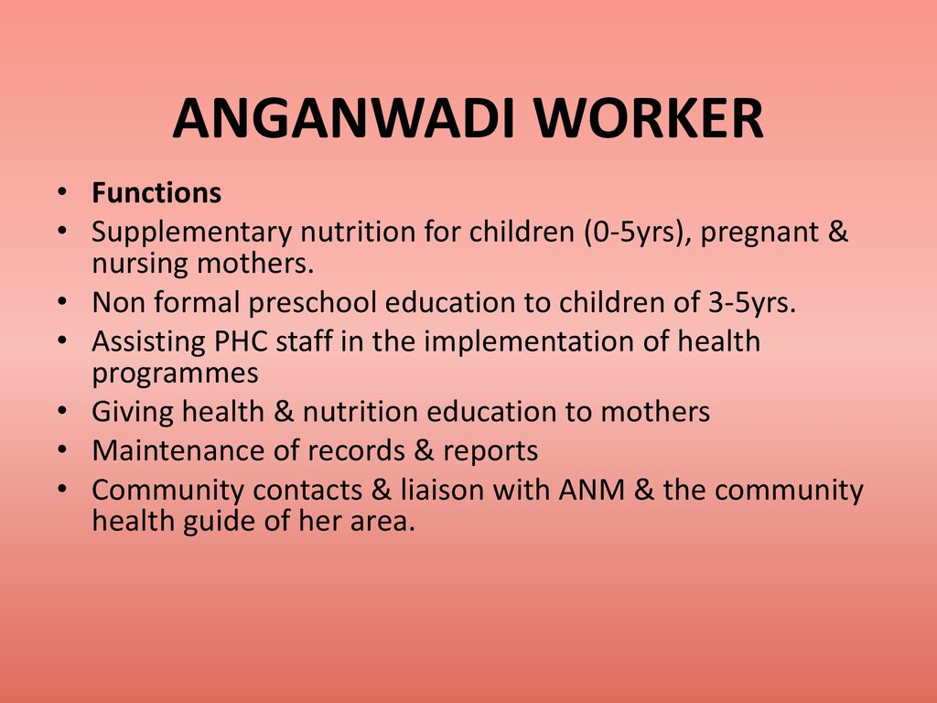

Slide 41
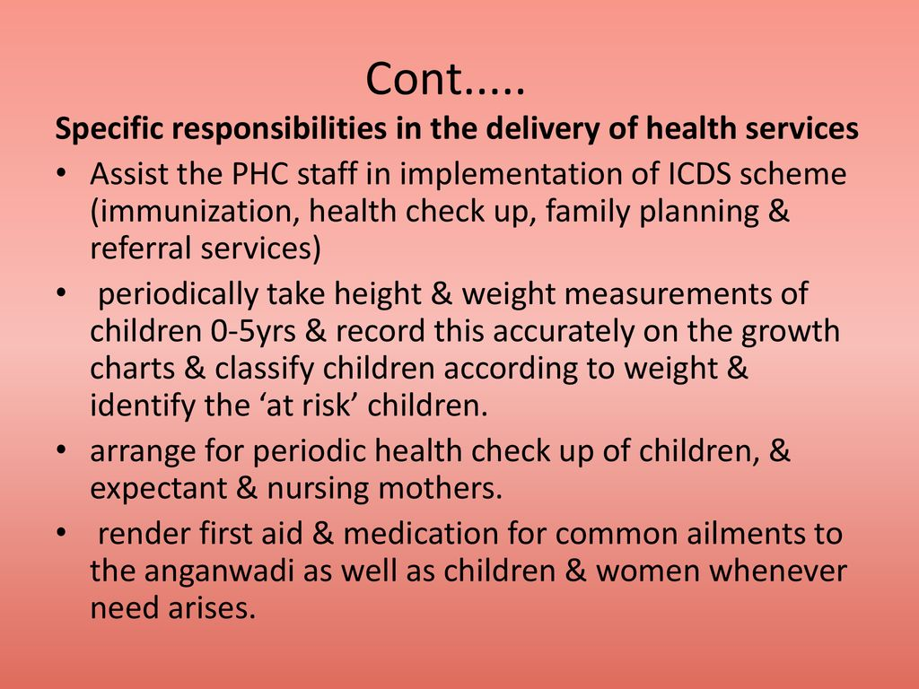

Slide 42
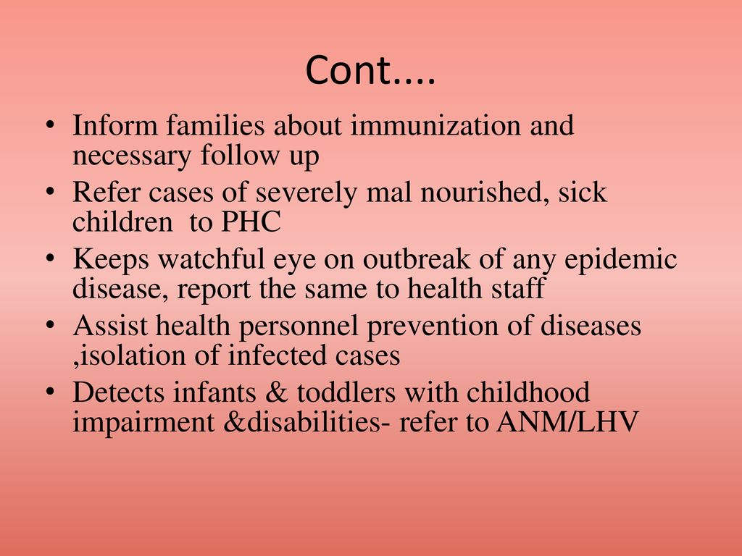

Slide 43
SUMMARY
The community health nursing personnel are the integral part of serving the community of people that cant afford medical services or who don’t have health insurance.
Their first and foremost responsibility is patient care. They are also an integral part of keeping the patients health on track. They connect patients with other health care facilities and ensure they receive proper treatment.

Slide 44
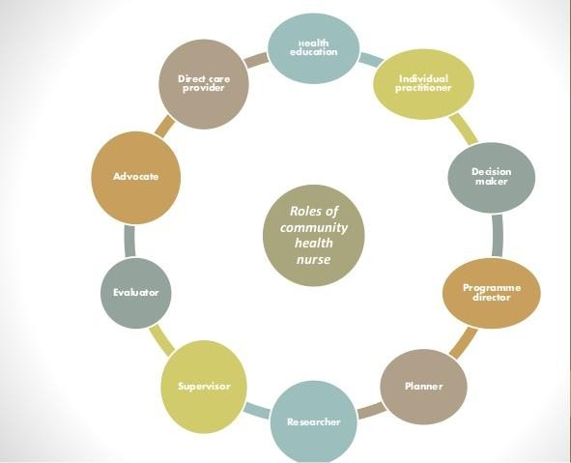
SUMMARY

Slide 45
EXPECTED QUESTIONS
Essay: (15 marks)
Describe various job description of community health nursing personnel in detail
Short Notes: ( 5 marks)
Explain the responsibilities of community health nurse
Discuss the functions of health assistants in the community
Short Answers:(2 marks)
Define community health nursing process
Abbreviate the terms ASHA. ANM and AWW
52

Slide 46
REFERENCE
K. Park(2009), “Textbook of Preventive and Social Medicine” 20th Edition, M/s. Banarsidas bhanot publishers
Prof.Dr.E. Vijay, “Textbook of Community Medicine” 2nd edition, Beacon zen publishers
Kasthuri Sundar Rao, “Introduction to community Health Nursing”, 4th edition B.I. Publications
53

Slide 47


