Slide 1
ANTE PARTUM HAEMORRHAGE
Mrs. JUSTY JOY
ASSISTANT PROFESSOR
OBG DEPARTMENT
JUBILEE MISSION COLLEGE OF NURSING

Slide 2
Central objective
At the end of teaching session the students will gain knowledge on antepartum hemorrhage and able to apply this knowledge into practice with a positive attitude
Specific objectives
The students will be able to
Define antepartum haemorrhage
Identify causes
Describe types of placenta previa
List down complications of placenta previa
Define abruptio placenta
Explain causes
Describe clinical features and complications of abruptio placenta
Describe management of abruptio placenta

Slide 3
DEFINITION
Antepartum haemorrhage is defined as bleeding from or into the genital tract after 28th week of pregnancy and before the birth of the baby .
Incidence is 3 % among hospital deliveries

Slide 4
CAUSES
PLACENTAL PLACENTA PREVIA
ABRUPTO PLACENTA
UNEXPLAINED----INDETERMINATE BLEEDING
EXTRA PLACENTAL CERVICAL POLYP
Ca CERVIX
VARICOSE VEIN
LOCAL TRAUMA

Slide 5
PLACENTA PREVIA
DEFINITION
It is defined as when placenta is implanted partially or completely in the lower uterine segment (over or adjacent to internal os)
The term previa (L, in front of) denotes the position of the placenta in relation to the presenting part.

Slide 6
Incidence – 0.5 to 1%
Common in
  80% occur in multipara
  More than 35 years is more common
  Multiple pregnancy
  High birth order

Slide 7
Etiology
  Dropping down theory
  Persistent chorionic activity
  Defective decidual theory
  Big surface area theory

Slide 8
(a) Multiparity
(b) Increased maternal age (> 35 years)
(c) History of previous cesarean section or any other scar in the uterus (myomectomy or hysterotomy)
(d) Placental size (mentioned before) and abnormality (succenturiate lobes)
(e) Smoking — causes placental hypertrophy to compensate carbon monoxide induced hypoxemia.
(f) Prior curettage.

Slide 9
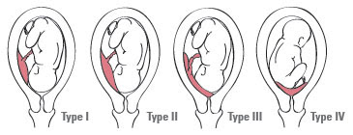
TYPES PLACENTA PREVIA

Slide 10
Type—I (Low-lying)
Type—II (Marginal): The placenta reaches the margin of the internal os but does not cover it.
Type—III (Incomplete or partial central): The placenta covers the internal os partially (covers the internal os when closed but does not entirely do so when fully dilated).
Type—IV (Central or total): The placenta completely covers the internal os even after it is fully dilated.

Slide 11
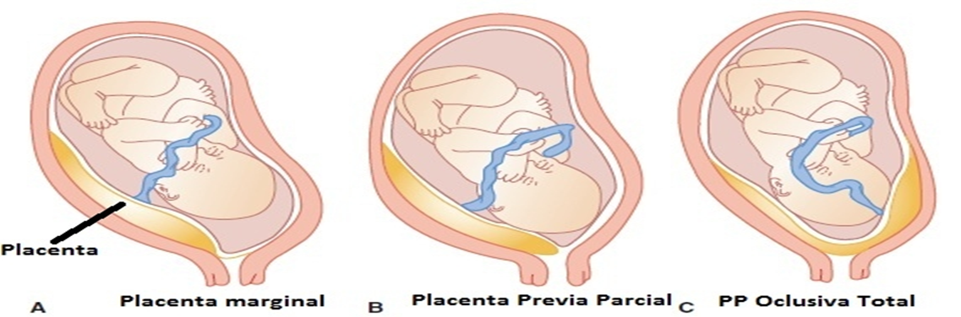

Slide 12
PATHOLOGICAL ANATOMY
  Placenta—The placenta may be large and thin, a tongue shaped extension from the main placental mass,extensive areas of degeneration with infarction and calcification may be evident. The placenta may be morbidly adherent due to poor decidua formation in the lower segment.
  Umbilical cord—The cord may be attached to the margin (battledore) or into the membranes (velamentous) which may rupture along with rupture of the membranes.
  Lower uterine segment—Due to increased vascularity, the lower uterine segment and the cervix becomes soft and more friable.

Slide 13
Causes of bleeding
    Placental growth
    Lower segment dilates
    Inelastic placenta
    Open uteroplacental vessels
  Causes of stop of bleeding
    Thrombosis
    Placental infraction
    Mechanical pressure
Migration
    18-20 weeks
    The term placental migration could be explained in two ways :
    (i) with the progressive increase in the length of lower uterine segment, the lower placental edge relocates away from the cervical os
    (ii) Due to trophotropism (growth of trophoblastic tissue towards the fundus), there is resolution of placenta previa.

Slide 14
CLINICAL MANIFESTATIONS
Symptoms | Signs
Painless recurrent bouls of bleeding – Acute onset, painless, causeless and recurrent Warning hemorrhage First bleeding will be less and recurrent episodes will be more Usually during sleep and unassociated with activity | General condition is proportional to blood loss The uterus feels relaxed, soft and elastic without blood loss Persistence of malpresentation Head floating Stallworthy sign Bleeding bright red Vaginal examination must not be done outside the operation theater
Clinical features

Slide 15
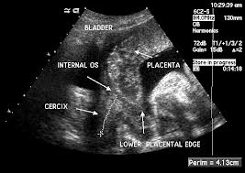

Slide 16
DIAGNOSIS
History
USG
  TAS:- The accuracy after 30th week of gestation is about 98 percent. False positive result may be due to full bladder or myometrial contractions. Poor imaging could be due to maternal obesity and posteriorly situated placenta.
  TVS: It is safe, obviates the discomfort of full bladder and is more accurate (virtually 100%) than TAS.
  Transperineal (TPS)
  Color Doppler flow study
MRI - Quality of placental imaging is excellent
Double set up examination - It is less frequently done these days
Examination of placenta after delivery

Slide 17
COMPLICATION
  Ante Natal – Shock, Malpresentations, Premature Labour, Death
  Intra Natal – Early Rupture of Membrane, Cord Prolapse, Slow Dilatation Of Cervix, Intrapartum Haemorrhage, Increased Operative Delivery, Post partum haemorrhage & Retained placenta
  Post Natal – Sepsis, Sub Involution, Embolism
  Fetal – Low birth weight baby, Asphyxia, Intra Uterine Death, Birth injury & Congenital malformation

Slide 18
PREVENTION
  Adequate antenatal care to improve the health status
  Antenatal diagnosis of low lying placenta at 20 weeks with routine ultrasound
  Significance of “warning hemorrhage” should not be ignored.
  Color flow Doppler USG in placenta previa is indicated to detect any placenta accreta.
  AT HOME:
    (1) The patient is immediately put to bed
    (2) Assess the blood los
    (3) Quick but gentle abdominal examination to mark the height of the uterus
    (4) Vaginal examination must not be done.
  TRANSFER TO HOSPITAL: Arrangement is made to shift the patient to an equipped hospital having facilities of blood transfusion, emergency cesarean section and neonatal intensive care unit (NICU).
  ADMISSION TO HOSPITAL: All cases of APH, even if the bleeding is slight or absent by the time the patient reaches the hospital, should be admitted.

Slide 19
MANAGEMENT
  Immediate attention
  Amount of the blood loss — by noting the general condition, pallor, pulse rate and blood pressure
  Blood samples are taken for group, cross matching and estimation of hemoglobin
  A large-bore IV cannula is sited and an infusion of normal saline is started and compatible cross matched blood transfusion should be arranged
  Gentle abdominal palpation to ascertain any uterine tenderness and auscultation to note the fetal heart rate
  Inspection of the vulva to note the presence of any active bleeding.

Slide 20
Vital prerequisites:
Availability of blood for transfusion whenever required
Facilities for cesarean section should be available throughout 24 hours
Selection of cases
  Mother is in good health status (hemoglobin > 10 g%; hematocrit > 30%)
  Duration of pregnancy is less than 37 weeks
  Active vaginal bleeding is absent
  Fetal well being is assured (USG).

Slide 21
EXPECTANT MANAGEMENT
Bed rest with bathroom privileges
Investigations—like hemoglobin estimation, blood grouping and urine for protein are done
Periodic inspection of the vulval pads and fetal surveillance with USG at interval of 2–3 weeks
Supplementary hematinics should be given and the blood loss is replaced by adequate cross matched blood transfusion, if the patient is anemic
When the patient is allowed out of the bed (2-3 days after the bleeding stops), a gentle speculum (Cusco’s) examination is made to exclude local cervical and vaginal lesions for bleeding.
Use of tocolysis (magnesium sulfate) can be done if vaginal bleeding is associated with uterine contractions
Use of cervical circlage to reduce bleeding and to prolong pregnancy is not helpful
Rh immunoglobin should be given to all Rh negative (unsensitized) women.

Slide 22
Hospital setting is ideal.
Termination of the expectant treatment: The expectant treatment is carried up to 37 weeks of pregnancy. By this time, the baby becomes sufficiently mature.
Steroid therapy is indicated when the duration of pregnancy is less than 34 weeks. Betamethasone reduces the risk of respiratory distress of the new born when preterm delivery is considered

Slide 23
Active management
    Bleeding occurs at or after 37 weeks
    Patient in labour
    Bleeding is continuing
    Baby is dead
Cesarean section- is done for all women with sonographic evidence of placenta previa where placental edge is within 2 cm from the internal os. It is especially indicated if it is posterior or thick
Vaginal examination - Placental edge is 2-3 cm away from internal os

Slide 24
GENERAL REMARKS ON CESAREAN SECTION
The operation should be performed by a senior obstetrician with the help of an experienced senior anesthetist
Choice of anesthesia must be made by the anesthetist. Regional blockage may be used
If the patient is in shock state and the bleeding continues, the operation has to be performed immediately along with restorative measures. If, however, bleeding ceases, the operation may be deferred till the general condition improves with restorative measures
Low transverse abdominal incision is to be avoided. Instead, an infraumbilical longitudinal incision is preferred which not only saves time but also facilitates the classical operation if it seems necessary

Slide 25
Precautions during vaginal delivery
(1) All possible steps should be taken to restore the blood volume
(2) Methergin 0.2 mg should be given intravenously with the delivery of anterior shoulder to prevent blood loss in third stage
(3) Proper examination of the cervix should be done soon following delivery to detect any evidences of tear
(4) Baby’s blood hemoglobin level is to be checked and if necessary arrangements are to be made for blood transfusion.

Slide 26
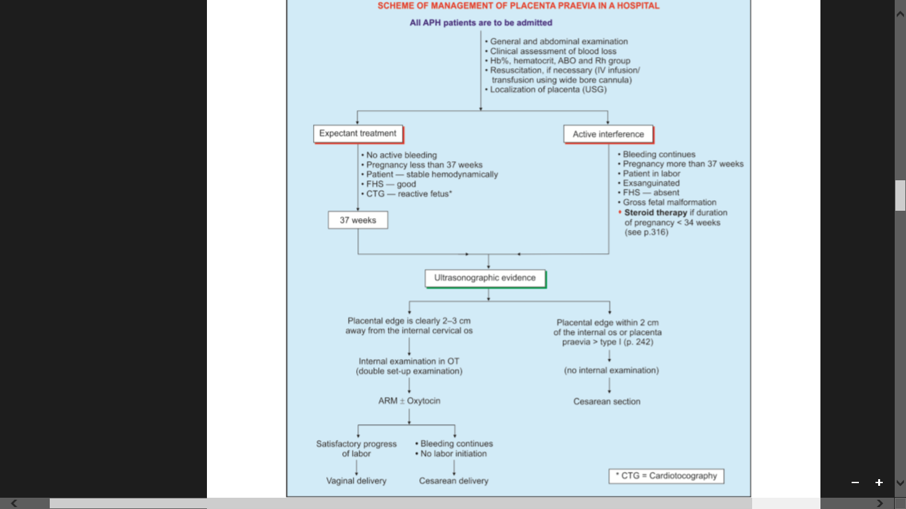

Slide 27
PROGNOSIS
MATERNAL: There has been a substantial reduction of maternal deaths in placenta previa throughout the globe.
FETAL: The reduction in perinatal deaths is principally due to judicious extension of expectant treatment thereby reducing the loss from prematurity, liberal use of cesarean section which greatly lessens the loss from hypoxia and improvement in the neonatal care unit

Slide 28
NURSING MANAGEMENT
Earlier diagnosis
Assessment with gentle paplapation on abdomen
Rest
Advise for management in home
Early interrvention
Periodical check up
Continuous fetal movement monitoring
Support to mother and family
Counselling

Slide 29
ABRUPTIO PLACENTA/ ACCIDENTAL HEMORRHAGE/ PREMATURE SEPARATION OF PLACENTA
It is a form of APH where the bleeding occurs due to premature separation of a normally situated placenta.
INCIDENCE –
  I in 200 delivery
  Perinatal mortality is 15-20%
  Maternal mortality is 2 – 5%

Slide 30
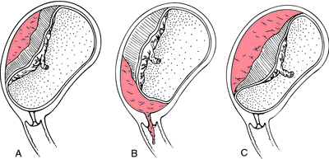
ABRUPTIO PLACENTA - TYPES
CONCEALED REVEALED MIXED

Slide 31
Revealed : Following separation of the placenta, the blood insinuates downwards between the membranes and the decidua. Ultimately, the blood comes out of the cervical canal to be visible externally. This is the commonest type.
Concealed : The blood collects behind the separated placenta or collected in between the membranes and decidua. The collected blood is prevented from coming out of the cervix by the presenting part which presses on the lower segment. At times, the blood may percolate into the amniotic sac after rupturing the membranes. In any of the circumstances blood is not visible outside. This type is rare.
Mixed : In this type, some part of the blood collects inside (concealed) and a part is expelled out (revealed). Usually one variety predominates over the other. This is quite common.

Slide 32
ETIOLOGY
Exact cause is unknown
More seen in
  High birth order
  Advanced age
  Poor socio economic status
  Malnutrition
  Smoking
  hypertension in pregnancy
  Trauma
  Sudden uterine compression
  Short cord
  Supine hypotension syndrome
  Placental anomaly
  Sick placenta
  Uterine factors
  Sick placenta
  Folic acid deficiency
  Torsion of uterus
  Cocaine abuse
  Thrombophilia
  Prior abruption

Slide 33
PATHOGENESIS
Depending on extension of abruption there may be degeneration and necrosis of decidua basalis
Rupture of basal plate
Hematoma at intervillous space
Retro placental hematoma
Depression on maternal surface and areas of infractions are visible
Spiral arteries may rupture

Slide 34
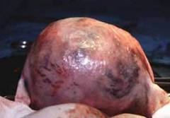
COUVELAIRE UTERUS
(UTERO PLACENTAL APOPLEXY)

Slide 35
COUVELAIRE UTERUS
It is a pathological entity first described by Couvelaire and is met with in association with severe form of concealed abruptio placentae. There is massive intravasation of blood into the uterine musculature upto the serous coat. The condition can only be diagnosed on laparotomy.

Slide 36
CLASSIFICATION
Grade 0 | Grade I | Grade II | Grade III
C/F are absent | Vaginal bleeding Uterus irritable & tenderness Maternal BP & fibrinogen unaffected | Vaginal bleeding Uterus irritable & tenderness Maternal BP increased & fibrinogen decreased shock is absent | Vaginal bleeding is severe Uterus irritable & tenderness Shock coagulation defect and anuria
FHS unaffected | FHS unaffected | Fetal distress or death | Fetal death

Slide 37
CLINICAL FEATURES AND DIAGNOSIS
Symptoms | Revealed | Concealed
Pain | Abdominal discomfort and pain | Acute intense pain
Bleeding | Continuous dark colour | Continuous dark colour or serous discharge
General condition | Proportionate | Shock may pronounced
Pallor | Related to blood loss | Severe
Features of eclampsia | Absent | Frequent association
Uterine height | Proportion to GA | More
Uterine feel | Normal feel | Uterus is tense, tender & rigid
Fetal parts, FHS | Identifiable & present | Diffuse & usually absent
Urine output | normal | diminished

Slide 38
Symptoms | Revealed | Concealed
Hb | Low value and proportional | Moderately lower & not in proportion
Coagulation profile | unchanged | Clotting time increases & fibrinogen and platelet become low
Urine for protein | absent | present

Slide 39
Complications….
revealed
Proportion to amount of visible blood loss
concealed
Haemorrhage, Shock, Blood coagulation disorders
PPH, oliguria, puerperal sepsis
fetal
Fetal death
Failure of lactation
Prematurity
Anoxia

Slide 40
PREVENTION
Elimination of knowing factors
Correction of anemia
Prompt detection and hospitalization

Slide 41
MANAGEMENT & NURSING MANAGEMENT
Emergency management
        Infusion
        Blood transfusion
        Coagulation profile
        Urine output
        Electronic fetal movement

Slide 42
Assessment
        Fetal status
        Grade of abruption
        Hb%, HCT& coagulation profile
        ABO & Rh group
        Depending on cervical condition and type of abruption CS or vaginal delivery can be decided

Slide 43
MANAGEMENT OPTIONS
(a) Immediate delivery
(b) Management of complications if there is any
(c) Expectant management (rare)
Definitive treatment is immediate delivery

Slide 44
The patient is in labor:
  The labor is accelerated by low rupture of the membranes.
  Rupture of the membranes with escape of liquor amnii accelerates labor and it increases the uterine tone also.
  Oxytocin drip may be started to accelerate labor when needed.
Vaginal delivery is favored in cases with:
  (i) Limited placental abruption
  (ii) FHR tracing is reassuring
  (iii) Facilities for continuous (electronic) fetal monitoring is available
  (iv) Prospect of vaginal delivery is soon or
  (v) Placental abruption with a dead fetus.

Slide 45
The patient is not in labor:
  (i) Bleeding continues
  (ii) > Grade I abruption Delivery either by
  (A) Induction of labor or
  (B) Cesarean section.
Induction of labor is done by low rupture of membranes.
Oxytocin may be added to expedite delivery. Labor usually starts soon in majority of cases and delivery is completed quickly (4-6 hours).
Placenta with varying amount of retroplacental clot is expelled most often simultaneously with the delivery of the baby.
Inj. oxytocin 10.IU IV (slow) or IM or Inj. methergin 0.2 mg IV is given with the delivery of the baby to minimise postpartum blood loss.
Oxytocics should be used to improve the uterine tone along with blood transfusion.

Slide 46
(B) Cesarean section: Indications are :
    (a) Severe abruption with live fetus
    (b) Amniotomy could not be done (unfavorable cervix)
    (c) Prospect of immediate vaginal delivery despite amniotomy is remote
    (d) Amniotomy failed to control bleeding
    (e) Amniotomy failed to arrest the process of abruption (rising fundal height)
    (f) Appearance of adverse features (fetal distress, falling fibrinogen level, oliguria).
Anesthesia during cesarean section: Regional anesthesia is generally avoided when there is significant hemorrhage. This is to avoid profound and persistent hypotension

Slide 47
EXPECTANT MANAGEMENT
Expectant management in a case of placental abruption is an exception and not the rule.
Cases where bleeding is slight and has stopped (Grade I abruption), fetus reactive (CTG) and remote from term, may be considered.
The goal of expectant management is to prolong the pregnancy with the hope of improving fetal maturity and survival.
Continuous electronic fetal monitoring is maintained. Patient should be observed in the labor ward for 24-48 hours to ensure that no further placental separation is occurring.
Corticosteroid has to be given if preterm

Slide 48
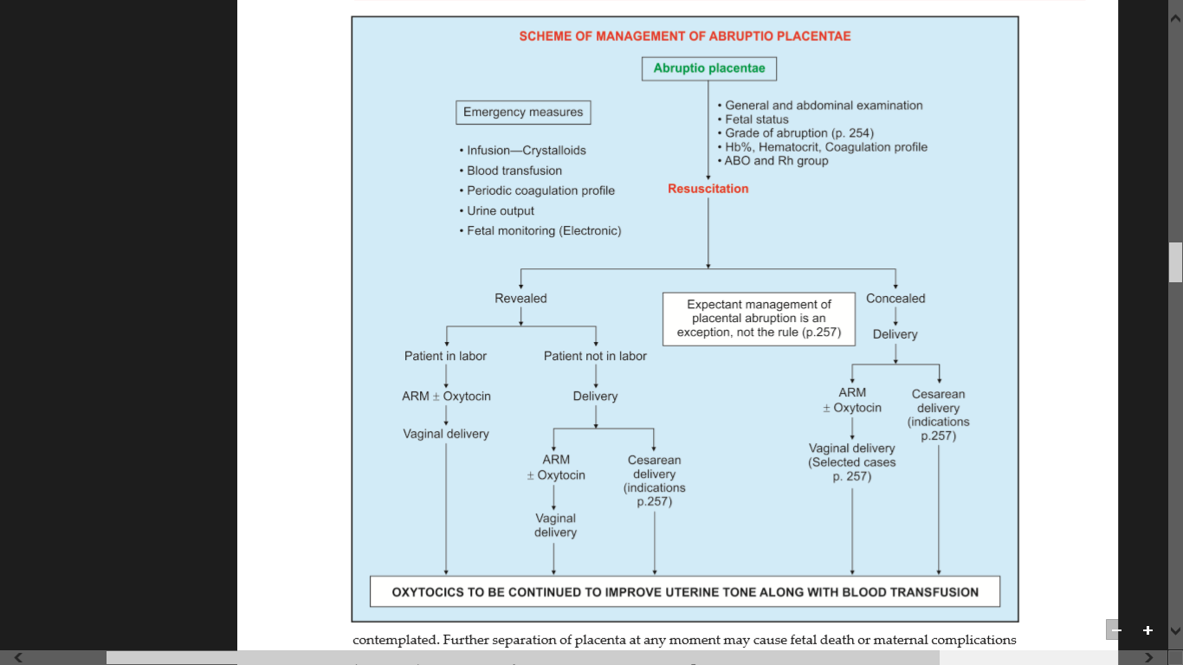

Slide 49
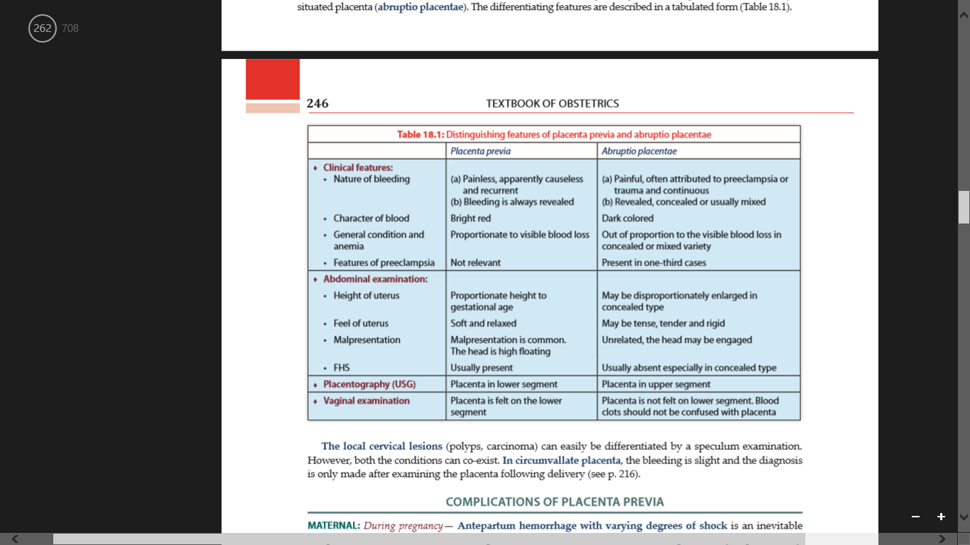

Slide 50
INDETERMINATE BLEEDING
The exact cause of vaginal bleeding in late pregnancy is not clearly understood in few cases.
The diagnosis of unclassified bleeding should be made after exclusion of placenta previa, placental abruption and local causes
Rupture of vasa previa, marginal sinus hemorrhage, circumvallate placenta, marked decidual reaction on endocervix or excessive show may be a possible cause of such bleeding.

Slide 51
REFERENCE
Dutta D C. Text book of obstetrics. Jay pee publishers.
Sheila Balakrishnan. Text book of obstetrics. Paras book publishers
A V Raman. Maternity nursing family,newborn and womens health care. Williams and wilkins publishers.
Adele Pillitteri. Maternal and child health nursing. Lippincott william amd wilkins publishers.

Slide 52
Quiz?
https://forms.gle/e2qpmJCYmHFEK8vY8

