Slide 1
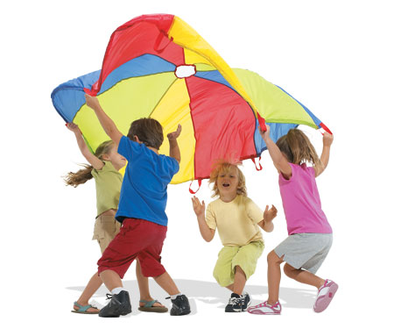
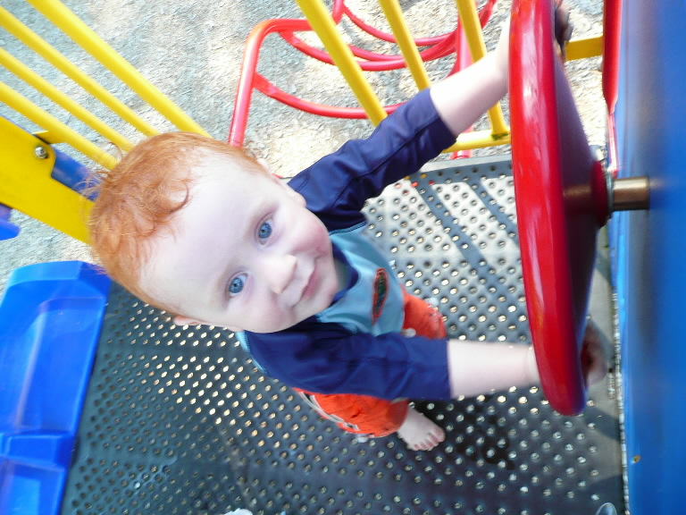
PLAY & CHILD DEVELOPMENT

Slide 2
OBJECTIVES
General Objective:- On completion of class student will acquire in depth knowledge regarding play and can apply this knowledge in their practice with a positive attitude .

Slide 3
Cont..
Specific Objective:- At the end of the class the student will be able to.
define the play
classify the play
explain the characteristics of different play
discuss the functions of play
plan health education for parents regarding the selection of age appropriate play materials

Slide 4
PLAY IS A CHILD’S WORK. PLAY IS IMPORTANT

Slide 5
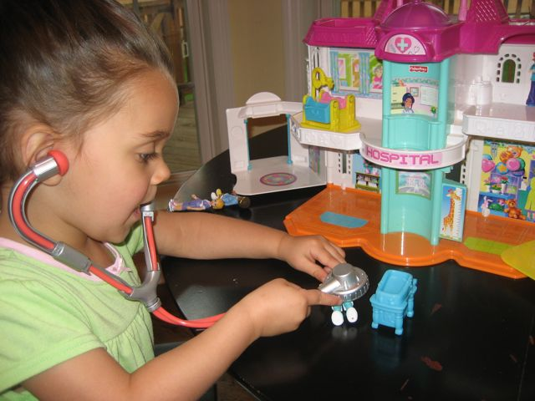
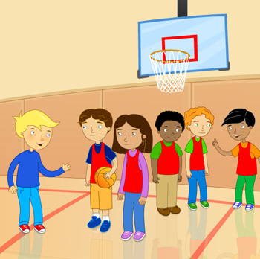

What is Play?
It is educational – it enables children to learn about themselves and the world around them
It provides an opportunity to make choices and problem solve
It allows children to use their imagination
It is a way of making friends
It is essential to a young child’s development

Slide 6

Classification of play
Content of play
The content of play involves primarily the physical aspect of the play, although social relationships cannot be ignored.

Slide 7
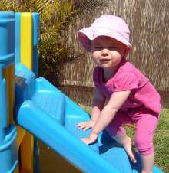
Cont…
Social –affective play
Sense – pleasure play
Skill play
Unoccupied behaviour
Dramatic or pretend play
games

Slide 8
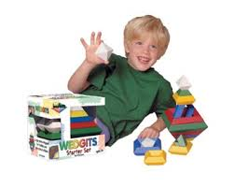
Social character of play
On looker play
Paralell play
Associative play
Cooperative play

Slide 9
BASED ON THE CONTENT

Slide 10

Social affective play
Infants take pleasure in relationship with the people. Infant response to adult talk and touch. They show behaviours like smiling, cooing etc.

Slide 11
Sense – pleasure play
In this type objects in the environment- light and colour, tastes and odors, textures and consistencies- attract children’s attention, stimulate their senses and give pleasure.
eg:- handling raw materials, body motions.

Slide 12
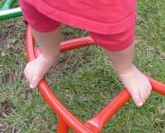
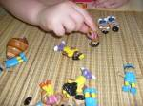
Skill play
Children persistently demonstrate and exercise their newly acquired abilities through skill play, repeating an action over and over again.
Eg:- learning to get in to a play car

Slide 13
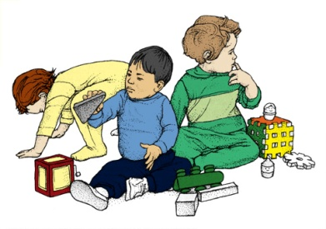
Unoccupied behaviour
In unoccupied behaviour children are not playful but focusing their attention momentarily on anything that strikes their attention. Children day dream, fiddle with clothes or other objects or walk aimlessly.

Slide 14
Dramatic or pretend play
It also known as symbolic play.
It start from late infancy(11-13 months)
Predominent in preschool children.
By acting out events of daily life, children learn and practice the roles modeled by the members of the family and society.

Slide 15

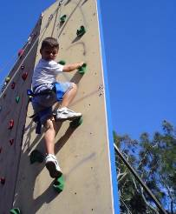
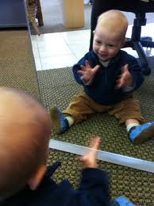
Games
Imitative game:- pat- a- cake, peek-a- boo
Formal games:
Competitive game

Slide 16
SOCIAL CHARACTER OF PLAY

Slide 17
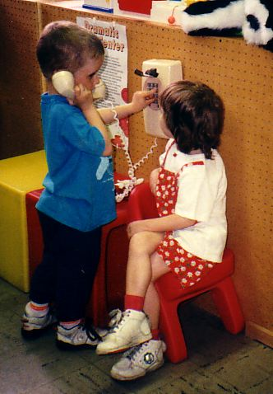
On looker play
Children watch what the other people are doing but make no attempt to enter in to the play activity. There is an active interest in observing the movements of others but make no effort to make close to or speak to them.

Slide 18
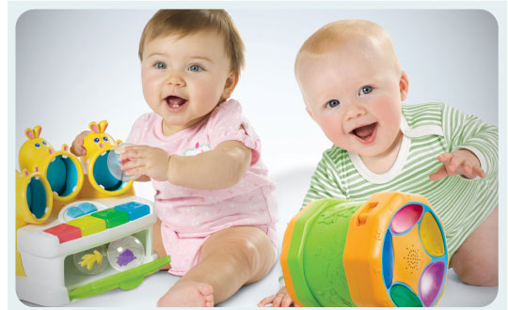
Solitary play
Children play alone with toys different from those used by other children in the same area. They enjoy the presence of other children but make no effort to get close to or speak to them.

Slide 19
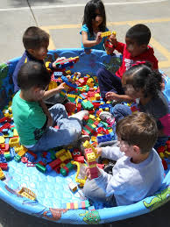
Paralell play
Children play independently but among other children. They play with the toys like those the children around them are using, but they neither influencing nor being influenced by other children
There is no group association
It is the characteristics of the toddlers.

Slide 20
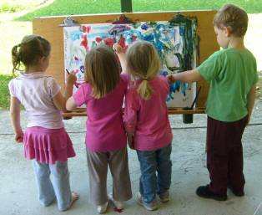
Associative play
In associative play children play together and are engaged in similar or even identical activities , but there is no organization, division of labor, leadership assignment and mutual goal.
No group goal
Children borrow and lend play materials.

Slide 21
Cooperative play
It is organized
Child play in a group with the other children
They discuss the plan of activities for the accomplishment of goal
In this type there is a goal and their attainment required organization of activities, division of labour and role playing
Activiity is controlled by one or two persons.

Slide 22

Functions of play
Sensory motor development
Sensory motor activity is the predominent form of play in infancy
Active play is essential for muscle development
Children gain an impression of self and the world

Slide 23

Intellectual development
Through exploration and manipulation children learn colors, shapes, sizes, textures and the significance of objects.
They learn the significance of numbers and how to use them.
Play help to develop problem solving skills.
Play provides means to practice and expand language skills
Books, stories and collections expand knowledge and provide enjoyment.

Slide 24
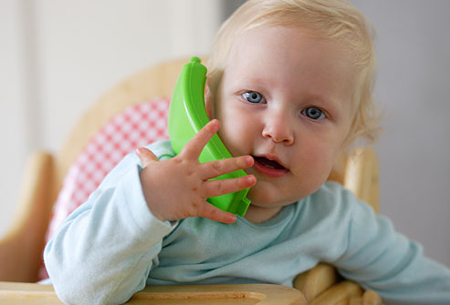
Socialization
Through play children learn to establish social relationships and solve problems associated with these relationship.
They learn to give and take
They learn sex role that society expects them to full fill, as well as approved behavior.

Slide 25
Creativity
Children can experiment and try out their ideas in play.
After children feel the satisfaction of creating something new and different, they transfer this creative interest to situations outside the world of play.

Slide 26
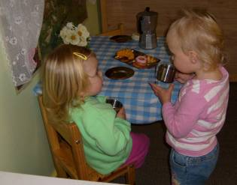
Self awareness
Beginning with active explorations of their bodies and awareness of themselves as separate from the mother.
Children learn who they are and their place in the world.
Children can regulate their own behaviour
Compare their abilities with that of others.

Slide 27
Therapeutic value
Children can express emotions and release unaceptable impulses in a socially acceptable manner.
Through play children can able to communicate their needs, fears and desires that are unable to express with their limited language skills

Slide 28

Moral value
Interactions with peers during play contributes significantly to their moral development training.

Slide 29

Others
Play activities help the child to develop muscular coordination and communication skills.
Helps in maintaining the body weight.
Develops more definite and realistic concepts.
Helps the children to understand the world in which they live and to distinguish reality and fantasy.
Makes the children to learn the problem solving approach

Slide 30

Cont..
Desirable personality traits will be acquired eg: cooperation, truthful and pleasantness.
Increases attention, concentration and ability in task oriented activities thus the child learns to control emotions.
Develops honesty, sportsman ship and compassion
It enables the child to develop characters such as self- control, self reliance and patience

Slide 31

STAGES OF PLAY DEVELOPMENT
Exploratory stage
from birth to three month infants enjoys play by seeing at people and objects, make random movements in grasping objects. After gaining voluntary control, child grasps, holds, examines objects within reach by creeping, crawling and walking.

Slide 32

Toy stage
Toddler enjoys with toys and feels that their toys have life and capable of acting talking and feeling. Preschoolers and school age children enjoys cooperative, associative play.

Slide 33

PLAY STAGE
Play becomes social and increases with age
Number of playmates decreases with age
As age advances the child engages their play activities with their own sex companions, follows rules, regulations in a formal manner.

Slide 34
Day dream stage
Adolescent losses interest in games and sports also. Whatever their desires, hobbies in which they are interested, they will like to enjoy and live.

Slide 35
Selection and care of play materials
Safe, washable, light weight , simple, durable, easy to handle and non breakable
Realistic, attractive constructive and offer problem solving opportunities
No sharp edges and no small removable parts which may be swallowed or inhaled
Not over stimulating and frustrating
No toxic paints, not costly, not inflammable and not excessive noisy

Slide 36
Cont..
Play things with electrical plug should be avoided, only children over 8 yrs should be permitted to use them
Supervision during play is important to avoid accidental injury

Slide 37
Education – children
Correct use of toys
Safe storing of toys
Keep play things in good condition
Keep away play materials of older children from younger

Slide 38
REFERENCE
Hockenberry.J.M.(2015) Wong’s Essentials of Pediatric Nursing (9th edition). Missouri:Mosby publications.PP-897-898
Marlow.R.D., and Redding. A.B,(2013).Textbook of Pediatric Nursing(6th edition). New Delhi: Publication.PP-476-491
Kyle Terri (2013) Essentials of Pediatric Nursing (2nd edition) Philadelphia: Lippincott Williams & Wilkins, PP:634-636
O.P.Ghai and et al (2013) Ghai Essential Pediatrics (8th edition) New Delhi: CBS publishers PP-402-404.

Slide 39
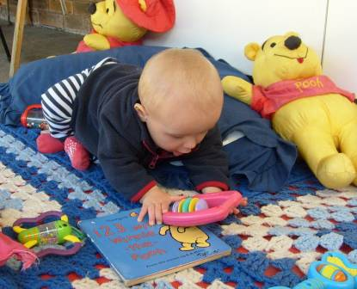
Thank you

