Slide 1
INTEGRATED MANAGEMENT OF NEONATAL AND CHILDHOOD ILLNESS
MODULE
DEPARTMENT OF CHILD HEALTH NURSING
JUBILEE MISSION COLLEGE OF NURSING
THRISSUR

Slide 2
CENTRAL OBJECTIVE
At the end of the class students will acquire knowledge regarding “Integrated Management of Neonatal and Childhood Illness” and develop desirable attitude and skills towards the topic and in future practice.

Slide 3
SPECIFIC OBJECTIVES
At the end of the class Students will be able to,
define IMNCI
enlist the objectives of IMNCI
describe the needs for IMNCI
enumerate the principles of IMNCI
state the guidelines of IMNCI
discuss the essential components of IMNCI
explain the case management process of IMNCI

Slide 4
Introduction
10 million children/year, die in developing countries due to Acute Respiratory infections, Diarrhea, Measles, Malaria and Malnutrition
1990 + WHO+ UNICEF + Other agencies = IMCI
India adopted as IMNCI

Slide 5
IMNCI
IMNCI is an integrated approach to child health that focuses on the well being of the whole child.
It focused primarily on the most common causes of child mortality-diarrhea, pneumonia, measles, malaria, and malnutrition, illness affecting children aged from birth to 2 months and 2 months to 5 year including both preventive and curative elements to be implemented by families.

Slide 6
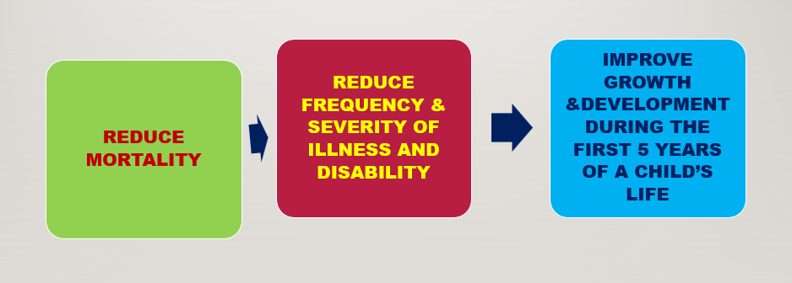
Objectives

Slide 7
Need/ rationale for IMNCI
Integrated approach is child centred
Three out of 4 children seeking health care in developing countries suffers from one of these conditions such as pneumonia, diarrhoea, measles, malaria and malnutrition
Often combination of these conditions leads to fatal result
Making a single diagnosis may be difficult
An integrated approach is needed to manage sick children to achieve better outcomes
The syndromic approach is a more realistic and cost-effective way to manage patients.

Slide 8
Need/ rationale for IMNCI
Careful and systematic assessment of common symptoms and well-selected clinical signs provides sufficient information to guide rational and effective actions.
An evidence-based syndromic approach can be used to determine the:
• Health problem(s) the child may have;
• Severity of the child’s condition;
• Actions that can be taken to care for the child (e.g. refer the child immediately, manage with available resources, or manage at home)

Slide 9
Principles of IMNCI
The treatment guidelines have been broadly described under two age categories:
Young infants age up to 2 months.
Children age 2 months up to 5 years.
The IMNCI guidelines are based on the following principles:
All children under 5 years of age must be examined for conditions which indicate immediate refferal
Children must be routinely assessed for major symptoms, nutritional and immunization status, feeding problems and other problems.
Only a limited number of carefully selected clinical signs are used for assessment.

Slide 10
Principles of IMNCI
Classification - a combination of individual signs is used to classify the severity of illness which calls for specific action rather than a 'diagnosis'. Classifications are colour coded and
suggest referral (pink),
initiation of treatment in health facility (yellow) or
management at home (green).
IMNCI guidelines address most common, but not all paediatric problems.
IMNCI management protocols use a limited number of essential drugs.
Caretakers are actively involved in the treatment of children.
IMNCI includes counselling of caretakers about home care including feeding, fluids and when to return to health facility.

Slide 11
Guideline of IMNCI
All sick infants up to 2 months of age must be assessed for “possible bacterial infection” and they must be routinely evaluated for the major symptoms
All sick children between 2 months and 5 years must be examined for “general danger signs” that indicate the need for immediate referral or admission to the hospital
All under 5 children who are sick must be routinely assessed for nutritional and immunization status, feeding problems, and other common day to day problems
A limited number of carefully selected clinical signs are used, based on their sensitivity and specificity, to diagnose common childhood diseases

Slide 12
Guideline of IMNCI
On the basis of combination of various signs, the child is classified into various groups and further divided into colour coded triage as pink which requires urgent referral or admission to a hospital, yellow when specific treatment is required through the outpatient department and green which calls for home management
The IMNCI guidelines address most but not at all the major reasons for which a sick infant or child is brought to the clinic
The management procedures outlined in the IMNCI protocols use a limited number of essential drugs and encourage active participation by caretakers in the treatment of sick infants and children

Slide 13
Guideline of IMNCI
An essential component of IMNCI guidelines lays emphasis on providing counselling and guidance to care takers about home care, optional feeding, administration of oral dehydration fluids, immunizations, healthy family lifestyles and the need for further management and follow up

Slide 14
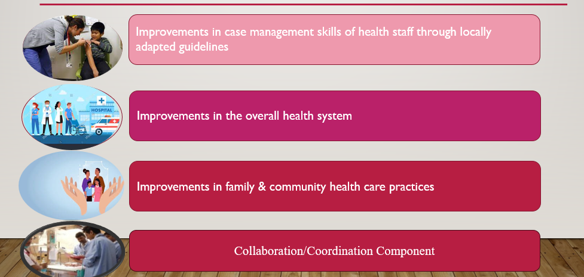
ESSENTIAL COMPONENTS OF IMNCI STRATEGY

Slide 15
Area of intervention with components
Training:
Skill-based: Training emphasizes practical skills.
Participatory approach: Combines classroom and hands-on clinical sessions.
Categories: Training for medical officers and frontline functionaries (ANMs, AWWs).
ASHA and link volunteers: Separate package for homecare prepared, considering educational status.
Training is crucial but not sole input for IMNCI implementation.

Slide 16
Area of intervention with components
2. Improvements to the Health System Component:
Availability of essential drugs at IMNCI-covered facilities.
Enhanced referral system to identified referral facilities.
Efficient referral mechanism for swift transfer of sick infants/children.
Functioning referral centers, strengthening weak healthcare systems.
Availability of health workers/providers at all levels.
Supervision and monitoring through follow-up visits and on-the-job support.

Slide 17
Area of intervention with components
3. Improvement of Family and Community Practices Component:
Promotion of healthy behaviors like breastfeeding, illness recognition, and early case seeking.
Information, Education, and Communication (IEC) campaigns for community awareness.
Counselling of caregivers and families during the management of sick children at health facilities.
Utilization of Home Visits for sickness identification and targeted Behavior Change Communication (BCC) for enhancing newborn and child care practices

Slide 18
Area of intervention with components
4. Collaboration/Coordination Component:
ANMs, Anganwadi workers, and grassroots involvement crucial.
Community participation vital, including PRIs and self-help, women’s groups.
District CMOs must engage concerned departments actively.

Slide 19
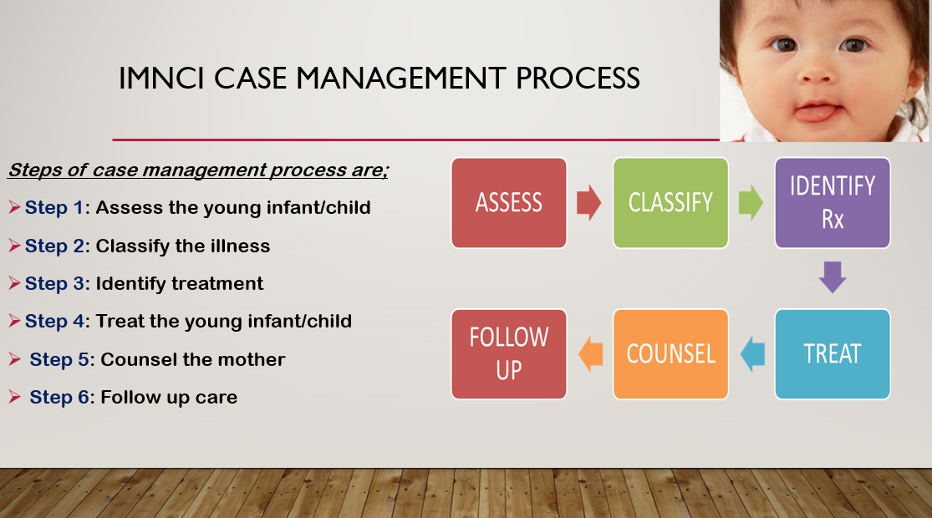

Slide 20
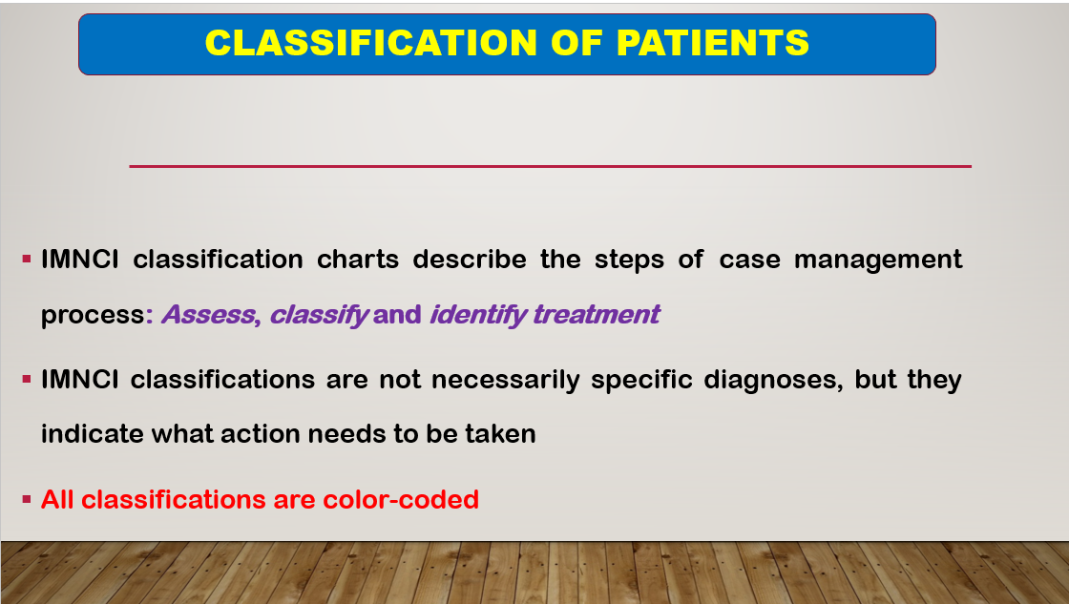

Slide 21
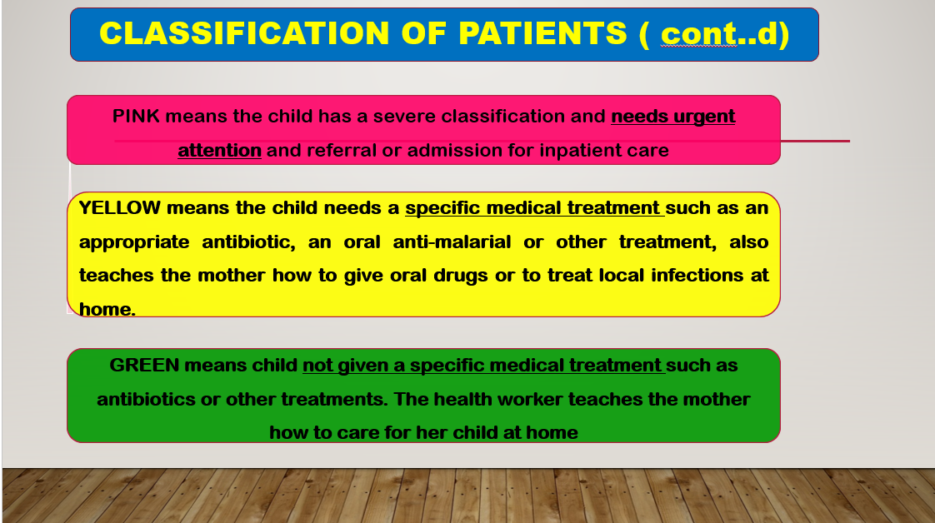

Slide 22


Slide 23
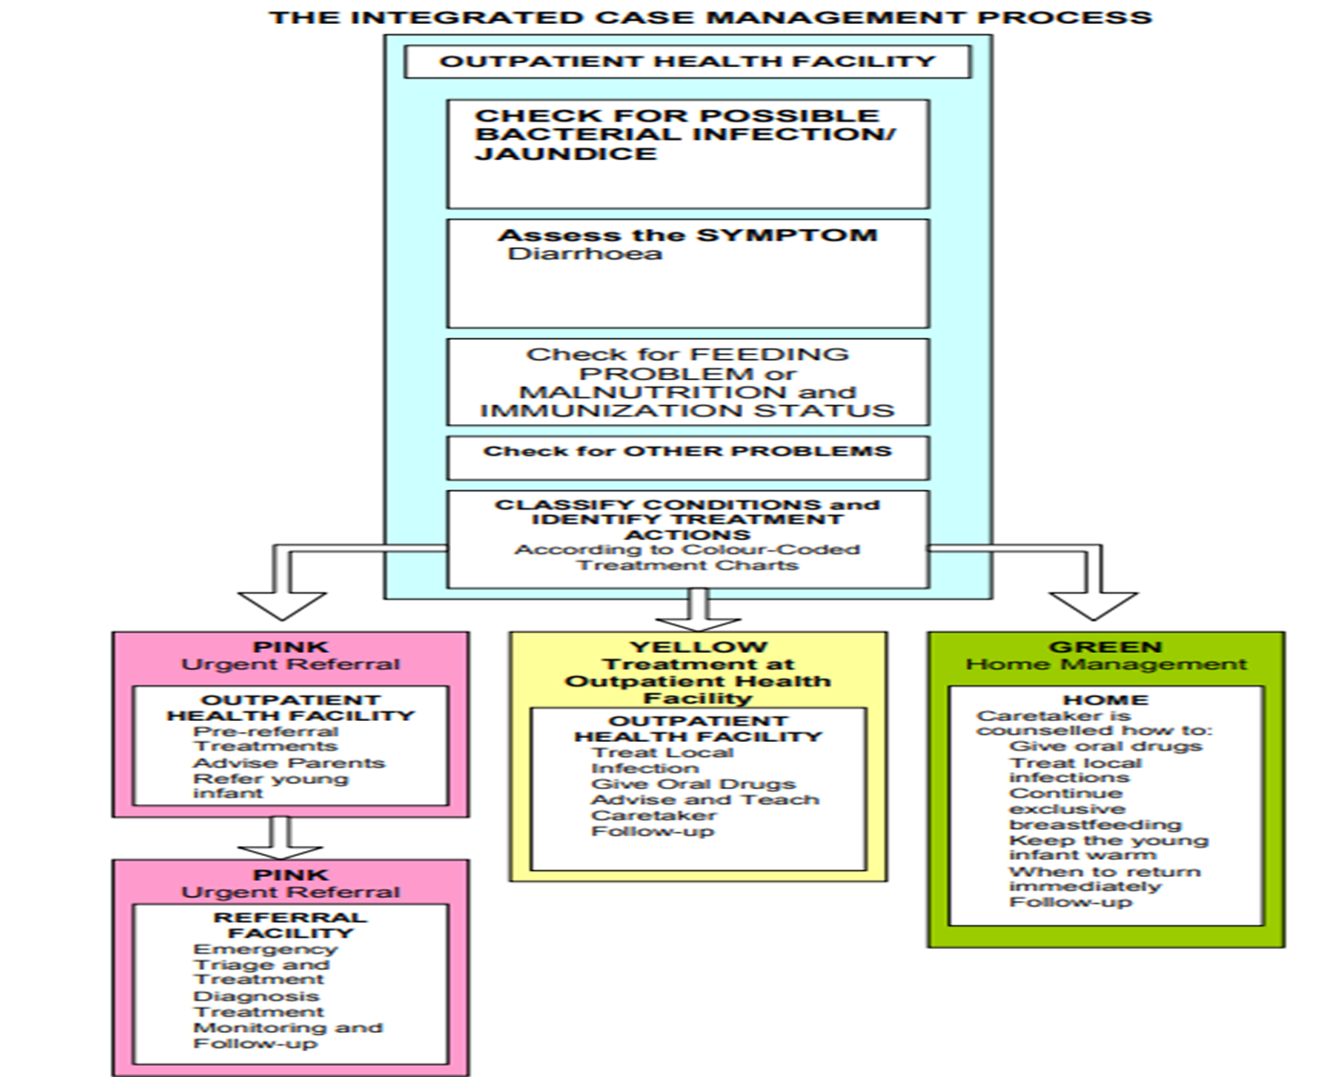

Slide 24
The IMNCI case management process
Assessment
Assess a child by checking first for general danger signs (or possible bacterial infection in a young infant), asking questions about common conditions, examining the child, and checking nutrition and immunization status. Assessment includes checking the child for other health problems.
Classification
Classify a child’s illnesses using a colour-coded classification system. Because many children have more than one condition, each illness is classified according to whether it requires:
Urgent pre-referral treatment and referral (pink), or
Specific medical treatment and advice (yellow), or
Simple advice on home management (green).

Slide 25
The IMNCI case management process
Identify treatment and treat
After classifying all conditions, identify specific treatments for the child. If a child requires urgent referral, give essential treatment before the patient is transferred. If a child needs treatment at home, develop an integrated treatment plan for the child and give the first dose of drugs in the clinic. If a child should be immunized, give immunizations.
Provide practical treatment instructions, including teaching the caregiver how to give oral drugs, how to feed and give fluids during illness, and how to treat local infections at home. Ask the caregiver to return for follow-up on a specific date, and teach her how to recognise signs that indicate the child should return immediately to the health post.
Assess feeding, including assessment of breastfeeding practices, and counsel to solve any feeding problems found. Then counsel the mother about her own health.

Slide 26
The IMNCI case management process
Follow-up care
When a child is brought back to the health post as requested, give follow-up care and, if necessary, reassess the child for new problems.

Slide 27
Assessment sick and young infant
Bacterial infection: Convulsions, Fast breathing > or = 60b/min, Severe chest indrawing, Nasal flaring, Grunting, Bulging fontanelle, skin pustules, a big boil, temperature, Lethargic or unconscious or Less than normal movements
Jaundice: Palms and soles yellow, Age < 24 hours or Age 14 days or more
Diarrhoea: signs of dehydration(general condition, sunken eyes, skin pinch - >2 secs, duration)
Feeding problem or malnutrition: Severely Underweight (<-3SD/ Zscore),Not low weight for age(≥ -2SD/ Z score )
Immunization
Other problems

Slide 28
Classification sick and young infant
Possible serious bacterial infection , Local bacterial infection, bacterial infection unlikely
Severe jaundice, Jaundice
Severe dehydration, Severe persistent diarrhoea, Severe dysentery,
Some dehydration, No Dehydration
Not able to feed - severe malnutrition, Feeding problem or low weight for age , No feeding problem
Immunization
Other problems

Slide 29
Assessment sick and young child
Danger signs: Convulsions, inability to drink or breastfeed , vomiting, lethargy, unconsciousness
Assess Main symptoms
Cough or difficulty in breathing: Chest indrawing or Stridor, fast breathing (2 months up to 12 months 50 breaths per minute or more, 12 months up to 5 years 40 breaths per minute or more.)
Diarrheoea: signs of dehydration(general condition, sunken eyes, skin pinch - >2 secs, duration)
Fever /malaria: Stiff neck or Bulging fontanelle, Fever, runny nose, duration
Measles now or within 3 months: Clouding of cornea, mouth ulcers, Pus draining from the eye
Ear problem: Tender swelling behind the ear, Pus draining from ear (duration</>14 days), ear pain.
Malnutrition: Visible severe wasting or Oedema of both feet, Severely Underweight, Not Severely Underweight, children with low weight(Z score less than –2) or very low weight (Z score less than –3) for age,
Anemia: Severe palmar pallor, Some palmar pallor
Immunization
Other problems

Slide 30
Classification sick and young child
5 Danger signs
Assess Main symptoms
Cough or difficulty in breathing: Severe Pneumonia Or very Severe disease, Pneumonia, No pneumonia/ Cough or cold
Diarrheoea: Severe dehydration/ severe persistent diarrhoea, Some dehydration/
persistent diarrhoea / dysentery, No dehydration
Fever /malaria: Very severe febrile disease, Malaria, Fever -Malaria unlikely
Measles: Severe complicated measles, Measles with eye or mouth complications, Measles
Ear problem: Mastoditis, Acute / chronic ear infection, No ear infection
Malnutrition: Severe malnutrition, Very low weight, Not very low weight
Anemia: Severe anemia, Anemia, No anemeia
Immunization
Other problems

Slide 31
Treatment package up to 2 months of age

Slide 32
Give first dose of IM antibiotics
Gentamicin (IM) -- dose: 5 mg per kg
Ampicillin (IM) -- dose: 100 mg per kg
If referral is not possible, give oral amoxycillin every 8 hours and intramuscular gentamicin once daily.

Slide 33
Give an Appropriate Oral Antibiotic
For local bacterial infection: Give oral amoxycillin or cotrimoxazole
AMOXYCILLIN: Give three times daily for 5 days
Birth up to 1 month (< 3 kg): Syrup (125 mg in 5 ml) -- 1.25 ml 3 times a day for 5 days.
1 month up to 2 months (3-4 kg): Syrup (125 mg in 5 ml) – 2.5 ml 3 times a day for 5 days. Tablet (250 mg) – ¼ tab 3 times a day for 5 days.
COTRIMOXAZOLE (trimethoprim + sulphamethoxazole): Give two times daily for 5 days
Birth up to 1 month (< 3 kg): Pediatric Tablet (20 mg trimethoprim +100 mg sulphamethoxazole) – ½ tab 2 times a day for 5 days.
1 month up to 2 months (3-4 kg): Pediatric Tablet (20 mg trimethoprim +100 mg sulphamethoxazole) – 1 tab 2 times a day for 5 days. Adult Tablet single strength (80 mg trimethoprim + 400 mg sulphamethoxazole) – ¼ tab 2 times a day for 5 days

Slide 34
Treat the Young Infant to Prevent Low Blood Sugar
If the child is able to breastfeed: Ask the mother to breastfeed the child.
10 ml/ kg orally: If the child is not able to breastfeed but is able to swallow: Give 20-50 ml (10 ml/kg) expressed breastmilk or locally appropriate animal milk (with added sugar) before departure. If neither of these is available, give 20-50 ml (10 ml/kg) sugar water.
10ml/kg OGT/NGT: If the child is not able to swallow: Give 20-50 ml (10 ml/kg) of expressed breastmilk or locally appropriate animal milk (with added sugar) or sugar water by nasogastric tube.
To make sugar water: Dissolve 4 level teaspoons of sugar (20 grams) in a 200-ml cup of clean water.

Slide 35
Warm the young infant using Skin to Skin contact (Kangaroo Mother Care)
Provide privacy to the mother. If mother is not available, Skin to Skin contact may be provided by the father or any other adult.
Request the mother to sit or recline comfortably.
Undress the baby gently, except for cap, nappy and socks.
Place the baby prone on mother’s chest in an upright and extended posture, between her breasts, in Skin to Skin contact; turn baby’s head to one side to keep airways clear.
Cover the baby with mother’s blouse, ‘pallu’ or gown; wrap the baby-mother duo with an added blanket or shawl.
Breastfeed the baby frequently.
If possible, warm the room (>25oC) with a heating device.

Slide 36
To Treat Skin Pustules or Umbilical Infection
Apply gentian violet paint twice daily.
The mother should: Wash hands. Gently wash off pus and crusts with soap and water. Dry the area and paint with gentian violet 0.5%. Wash hands.
Dry the Ear by Wicking
Dry the ear at least 3 times daily.
Roll clean absorbent cloth or soft, strong tissue paper into a wick. Place the wick in the young infant’s ear. Remove the wick when wet. Replace the wick with a clean one and repeat these steps until the ear is dry.

Slide 37
To Treat Thrush (ulcers or white patches in mouth)
Tell the mother to do the treatment twice daily.
The mother should: Wash hands. Wash mouth with clean soft cloth wrapped around the finger and wet with salt water. Paint the mouth with gentian violet 0.25%.

Slide 38
Teach Correct Positioning and Attachment for Breastfeeding
Show the mother how to hold her infant : -with the infant’s head and body straight - facing her breast, with infant’s nose opposite her nipple - with infant’s body close to her body - supporting infant’s whole body, not just neck and shoulders.
Show her how to help the infant to attach. She should: - touch her infant’s lips with her nipple - wait until her infant’s mouth is opening widen- move her infant quickly onto her breast, aiming the infant’s lower lip well below the nipple.
If still not suckling effectively, ask the mother to express breast milk and feed with a cup and spoon in the clinic.

Slide 39
Express breast milk: The mother should wash hands, sit comfortably and hold a cup or ‘katori’ under the nipple. Place finger and thumb each side of areola and press inwards towards chest wall. Do not squeeze the nipple. Press behind the nipple and areola between finger and thumb to empty milk from inside the areola; press and release repeatedly. Repeat the process from all sides of areola to empty breast completely. Express one breast for at least 3-5 minutes until flow stops; then express from the other side.

Slide 40
Teach the mother to feed with a cup and spoon
Place the young infant in upright posture (feeding him in lying position can cause aspiration)
Keep a soft cloth napkin or cotton on the neck and upper trunk to mop the spilled milk.
Gently stimulate the young infant to wake him up
Fill the spoon with milk, a little short of the brim
Place the spoon on young infant’s lips, near the corner of the mouth.
Gradually allow a small amount of milk to drip into young infant’s mouth making sure that he actively swallows it
Repeat the process till the young infant stops accepting any more feed, or the desired amount has been fed
If the young infant does not actively swallow the milk, do not insist on feeding; try again after some time

Slide 41
Teach the mother to treat breast or nipple problems
If the nipple is flat or inverted, evert the nipple several times with fingers before each feed and put the baby to the breast.
If nipple is sore, apply breast milk for soothing effect and ensure correct positioning and attachment of the baby. If mother continues to have discomfort, feed expressed breast milk with katori and spoon.
If breasts are engorged, let the baby continue to suck if possible. If the baby cannot suckle effectively, help the mother to express milk and then put the young infant to the breast. Putting a warm compress on the breast may help
If breast abscess, advise mother to feed from the other breast and refer to a surgeon. If the young infant wants more milk, feed undiluted anima milk with added sugar by cup and spoon.

Slide 42
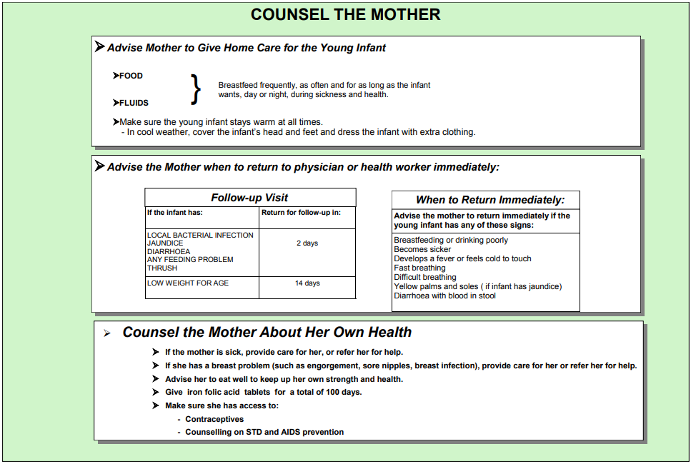

Slide 43
Treatment package sick young child ( 2 month to 5 years of age)

Slide 44
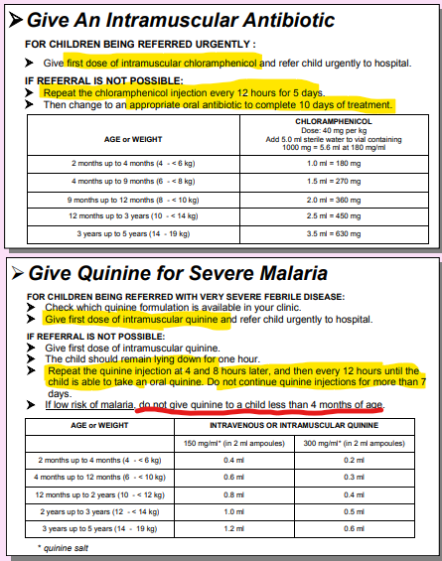

Slide 45
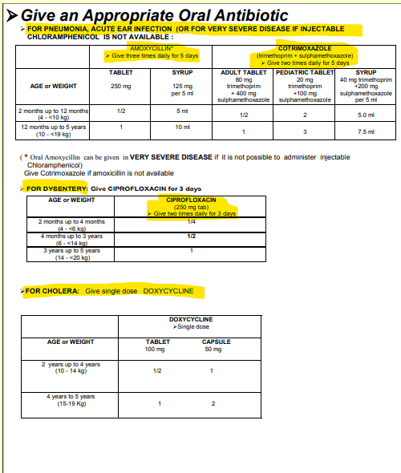

Slide 46
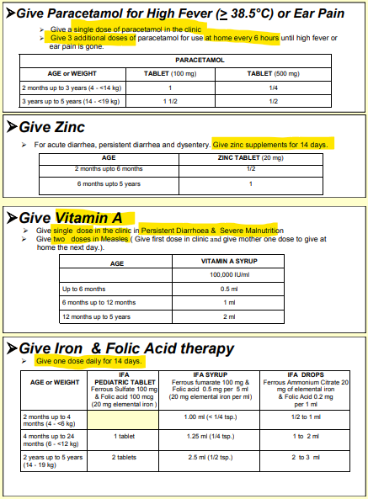

Slide 47
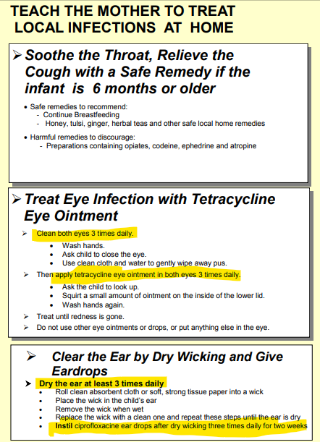

Slide 48
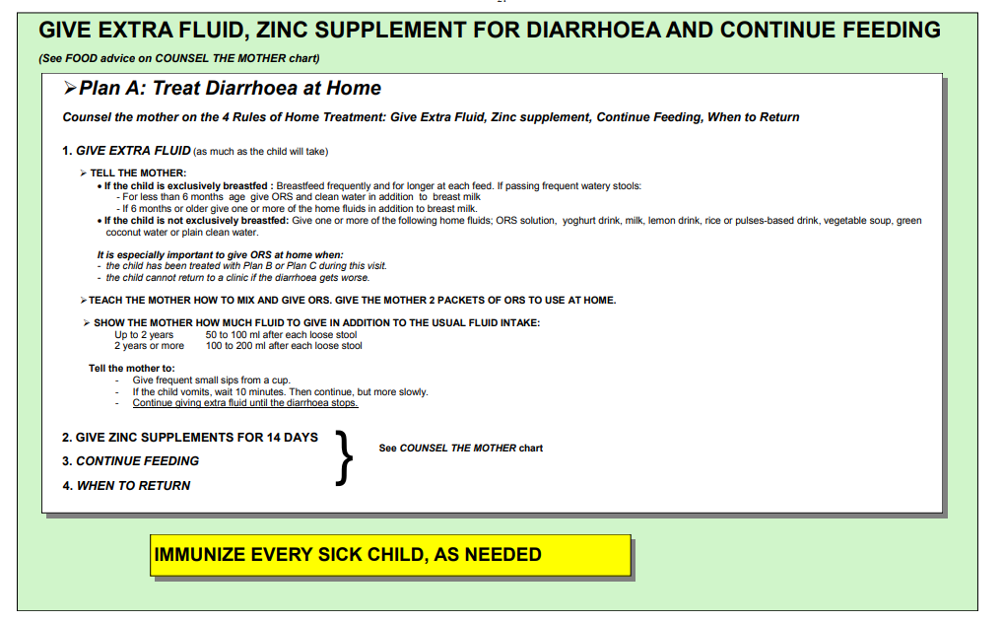

Slide 49
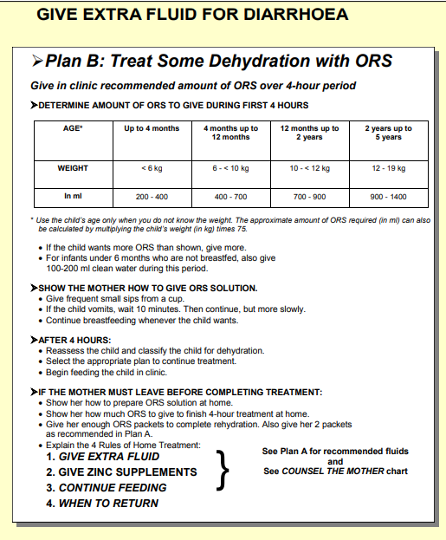

Slide 50
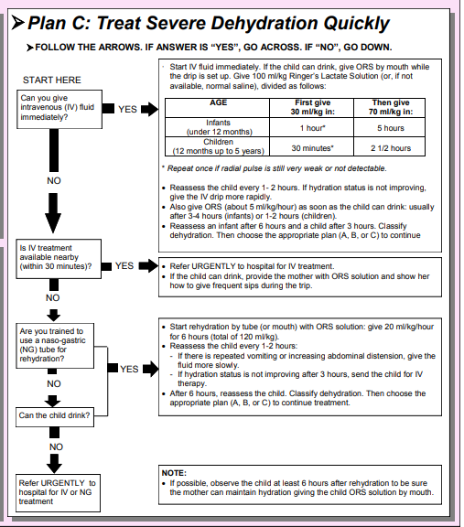

Slide 51
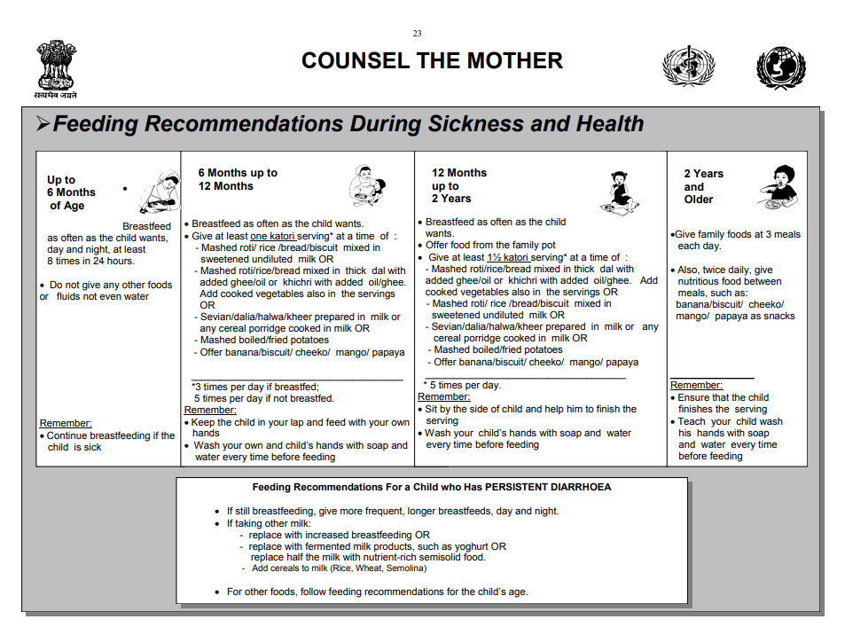

Slide 52
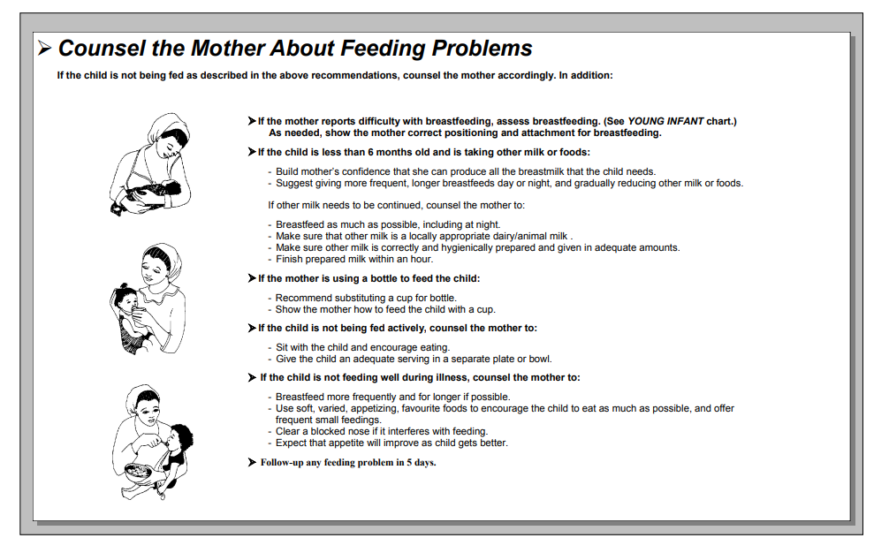

Slide 53
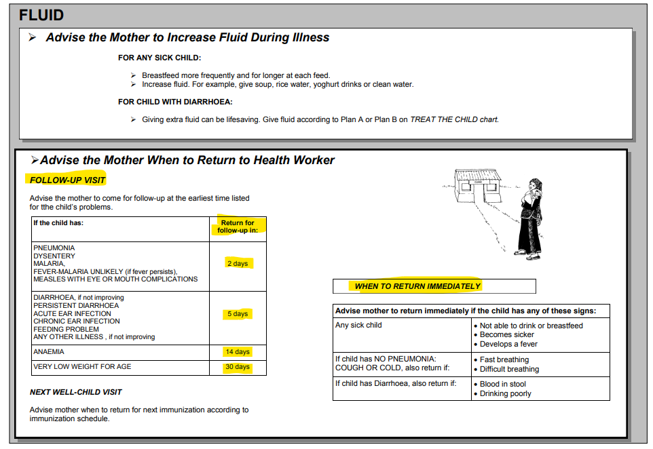

Slide 54
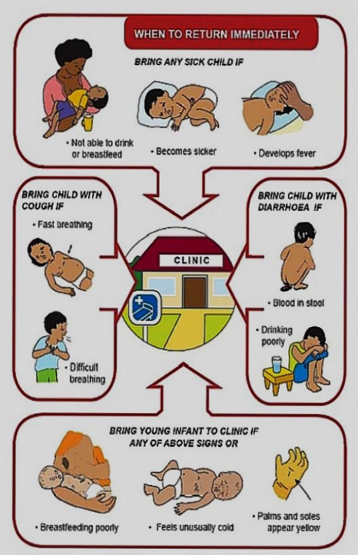

Slide 55
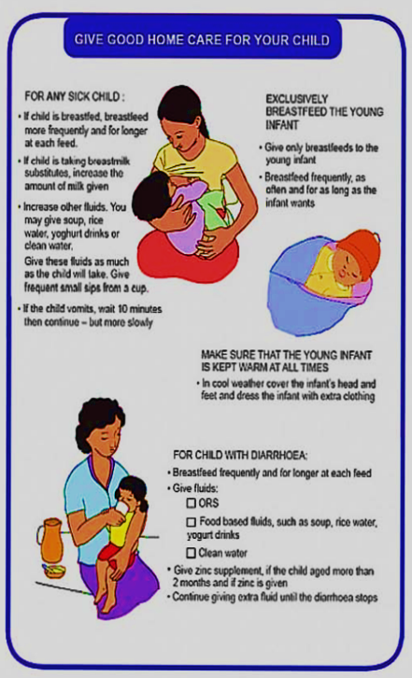

Slide 56
NEXT WELL-CHILD VISIT:
Advise when to return for the next immunization according to immunization schedule.
Follow up care:
When a child comes for follow-up of an illness, ask the mother or caretaker if the child has developed any new problems. If she answers yes, the child requires a full assessment: check for general danger signs and assess all the main symptoms and the child's nutritional status.
If the child does not have a new problem, use the IMNCI follow-up instructions for each specific problem:
Assess the child according to the instructions;
Use the information about the child's signs to select the appropriate treatment;
Give the treatment.
Note: If a child who comes for follow-up has several problems and is getting worse, or returns repeatedly with chronic problems that do not respond to treatment, the child should be referred to a hospital.

Slide 57
REFERENCES
Betz, Cecily Lynn. and Linda A Sowden. Mosby's Paediatric Nursing Reference. 6th ed. St. Louis, Mo., Mosby/Elsevier, 2008.
Hockenberry, M.J. and Wilson, D. (2009) Wong's Essentials Of Pediatric Nursing. 8th Edition, Elsevier Mosby, St. Louis.
Ball JW, Bindler RC, Cowen KJ. Child Health Nursing: Partnering with Children and Families. Update, 3rd ed. East Rutherford, NJ: Prentice Hall; 2018.
https://shop.lww.com/Essentials-of-Pediatric Nursing/p/9781975139841#editor_accordian

