Slide 1
ELECTRO CONVULSIVE THERAPY
Sr Priya Mathew
Lecturer, Dept. Psychiatric Nursing
JMCON

Slide 2
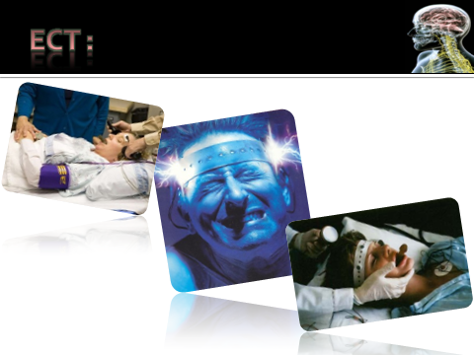

Slide 3
Introduction
  1) It is painless form of electric therapy.
  2) It is used for patient with depression & schizophrenic disorder.
  3) It is prepared by barbiturate anesthesia and an injection of chemical relaxant.
  4) An electric shock applied for a fraction of a second through electrodes placed on the temporal region.

Slide 4
DEFINITION
  Electro convulsive therapy is the induction of grandmal seizure through the application of electrical current to the brain through electrodes applied on the patient’s head.
  Cereleti and Bini are first neuropsychiatrist who used electro convulsive therapy in 1937.

Slide 5
PROCEDURE
There are two basic techniques
Direct ECT : in which ECT is given in the absence of general anesthesia and muscular relaxation
Modified ECT : ECT is modified by drug induced general anesthesia and muscular relaxation

Slide 6
Placement of electrodes
Bilateral
This is the standard form of ECT
Most commonly used
Electrodes are placed 2.5cm above the midpoint on the line joining the tragus of ear and lateral canthus of the eye.

Slide 7
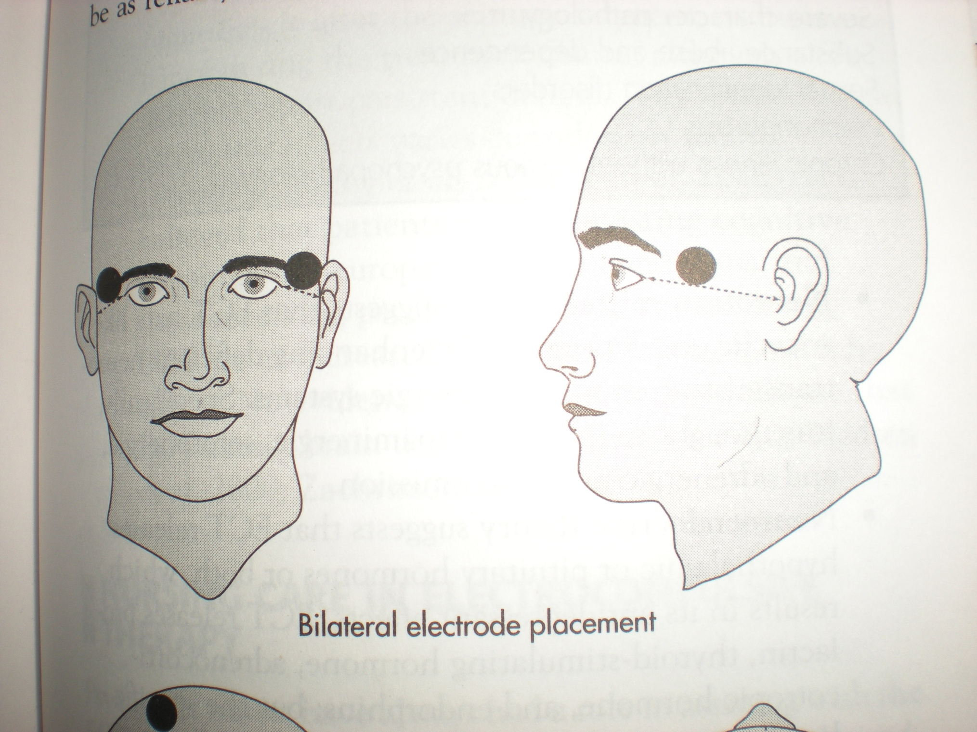

Slide 8
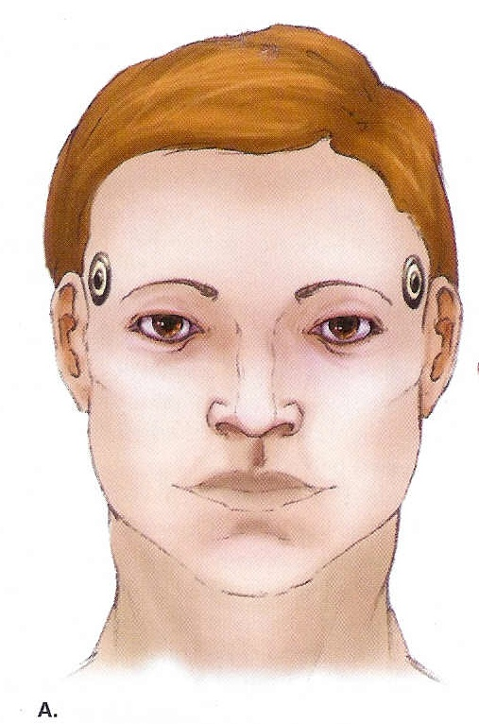
  BILATERAL ELECTRO CONVULSIVE THERAPY –

Slide 9
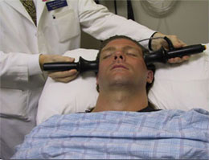

Slide 10
Unilateral
Electrodes are placed on one side of the head
Usually on non dominant side

Slide 11
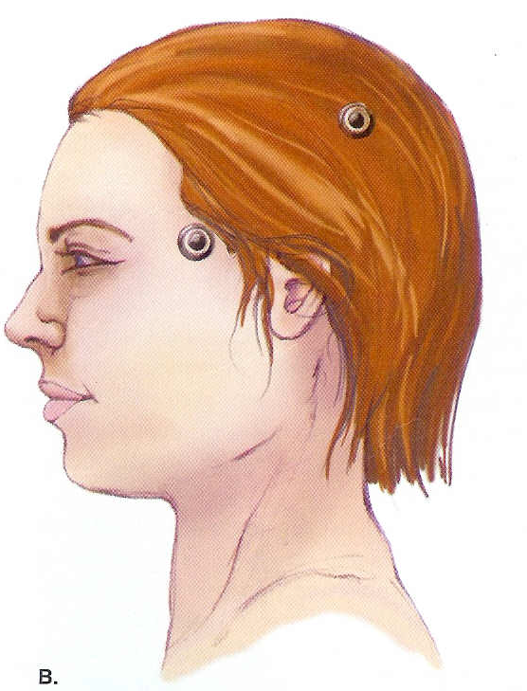
  2) Unilateral electro convulsive Therapy -

Slide 12
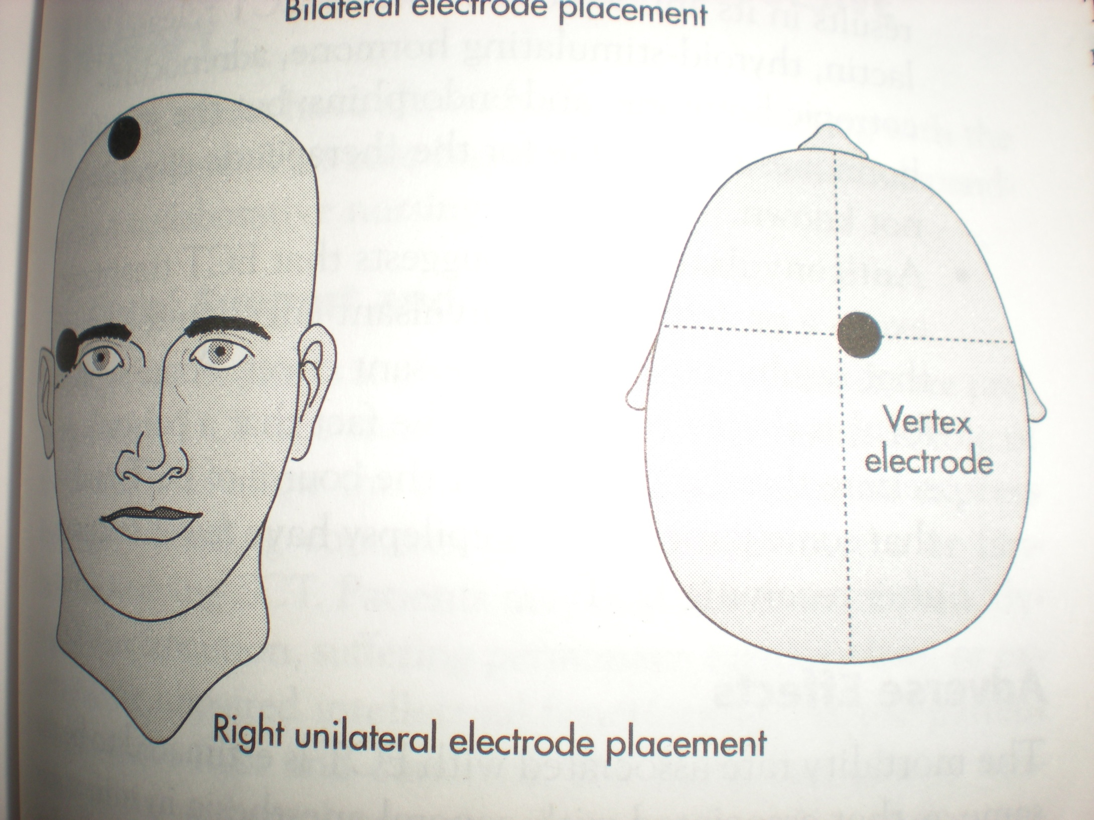

Slide 13


Slide 14
PROCEDURE
The usual dose current for obtaining an adequate response is 90-150volt[average 110volts] is administered for 0.1 to 1 .0 sec[average 0.6sec]
The therapeutic adequacy of the treatment is gauzed by generalized tonic –clonic seizures lasting for not< 25 to 30 sec
Patients usually require about 6 to 10 ECTs administered twice or thrice in a week

Slide 15
Mechanism of action
Neurotransmitter theory
ECT enhances the deficient neurotransmission in monoaminergic system especially the dopaminergic ,serotonergic and adrenergic neurotransmission

Slide 16
INDICATION
Major depression
most important
suicidal risk patients
poor intake of food and fluid
with psychotic features
unsatisfactory response to drug therapy
Mania
  rarely used
  effective in the treatment of clients who do not respond to lithium or other drug treatment
when life is threatened by dangerous behaviour
Schizophrenia
acute scizophrenia
scizophrenia accompanied with catatonic or affective symptomatology

Slide 17
CONTRAINDICATION
Absolute
Presence of raised ICP
Relative (care to be taken)
Recent MI
Severe HTN
CVA
Severe pulmonary disease
Retinal detachment
Pheochromocytoma

Slide 18
ADVERSE EFFECTS
Cardiovascular changes
Systemic effects such as headache,nausea,muscle soreness and drowsiness
Cognitive effects such as confusion or memory disturbances immediately after ECT

Slide 19
Pretreatment Interventions
Make sure about informed consent
Assist with complete physical examination
Evaluate cardiovascular assessment and pulmonary status
Blood tests and urine analysis
Examination of fundus to rule out papilledema
X ray assessment
Record baseline vital signs
Remove dentures,eye glasses or contact lenses,jewelry,hairpins
Npo for 6to 8hrs

Slide 20
Premedication according to the order
Make sure hair is clean and dry to facilitate optimal electrode contact
Stay with the client to relieve anxiety
Maintain a positive attitude about the procedure
Encourage the client to verbalize the feelings
Preparation of treatment room
A crash cart and defibrillator should be readily available

Slide 21
Interventions during procedure
Be with the client during procedure
Place the patient on supine position
Attach the patient to the monitor
Place an I/V cannula
Assist the anesthesiologist while administering the medication
Administer oxygen
A blood pressure cuff should be placed on the lower leg and inflated above systolic pressure prior to the injection of succynyl scoline

Slide 22
An airway or bite block is placed in the client's mouth
Electrodes are placed bilaterally to deliver electric stimulation
Ensure the patency of airway. provide suctioning if needed
Observe the vital signs and cardiac functioning
Provide support to the client’s arms and legs during seizure
Observe and record the type and amount of movement induced by the seizure

Slide 23
Post treatment Interventions
Continue to oxygenate the client until spontaneous respiration returns
Monitor pulse ,respirations and blood pressure every 15minutes for the first hour
Position the client on side to prevent aspiration
Orient the client to time and place
Check for gag reflex
Describe what has occurred
Provide reassurance that any memory loss the client may be experiencing is only temporary

Slide 24
Stay with the client until he or she is fully awake, oriented and able to perform self-care activities without assistance
Provide the client with a highly structured schedule of routine activities to minimize confusion
Allow the client to verbalize anxieties and fears

Slide 25
ARTICLES | PURPOSE
1) Electrode paste and gel alcohol, preps, saline. | 1) Concentrated saline is a good conductor of electricity, there by it facilitates in producing convulsion.
2) Electroencephalogram. | 2) Recording of electrical activity of brain through surface electrodes.
3) Blood pressure cuff (two) peripheral nerve stimulator and pulse oxymeter. | 3) To monitor vital parameter.
4) Stethoscope. | 4) To check the heart beats.
5) Reflex hammer. | 5) To check the muscle tone.
6) Intravenous and venipuncture supplies. | 6) To introduce the anesthetic drug and Intravenous fluid.

Slide 26
ARTICLES | PURPOSE
7) Mouth gag or tongue depressor. | 7) To prevent biting of tongue or injury to lips.
8) Stretcher with firm matters and side rails. | 8) To prevent injury.
9) Suction device. | 9) To prevent the patient from aspiration pneumonia.
10) Ventilation equipments including tubing, masks, ambu bag, oral airways, and intubations equipment with an oxygen delivery system capable of providing positive pressure oxygen. | 10) To prevent the patient from respiratory and cardiac complication.
11) Emergency and other medications as recommended as recommended by anesthesia staff. | 11) To handle the emergency situation during electro convulsive therapy.

Slide 27
  OBSERVATION –
  The production of grand mal seizure is necessary for direct and modified electro convulsive therapy.
  The Tonic phase – It is muscle contractions last for 10 seconds approximately.
  The clonic phase – It is movement for convulsion lasts for 25 to 30 seconds
  approximately. Then the patient goes in to the relaxation phase.
  The physician can see changes in Electroencephalograph also.
  With the use of anesthesia in modified electro convulsive therapy, mild grimace or blepharo spasm (A tonic spasm of the eyelid muscles) is observed when the current is applied. There is a slow planter flexion (reverse babinski) during the tonic phase and there are fine movements of the toes during the clonic phase.
  Number and frequency of ECT treatment –
  Amount –
  70 to 130 volts for 1 to 1 second.
  200 to 1600 milliamp here
  Number and frequency –
  There is no clinical justification for fixed number of treatments.
  Depression – 5 – 10 treatments for bipolar disorder, manic type, schizoaffective
  disorder.
  Catatonic schizophrenia given three times a week.

Slide 28
NURSING INTERVENTION BEFORE GIVING ECT | RATIONAL
1) Check that a through physical examination chart including ECG, lung, bone, blood for Hemoglobin, Urine for sugar and other tests and albumin and x-rays is completed. | 1) To select the patient for ECT therapy.
2) Written consent or declaration for the treatment from the nearest relative after explaining the method of treatment and risks. Do not tell the patient that ECT will be given. The word current may cause fear in the patient. He may be told that “injection” will be given unless he is aware of the treatment relatives should be explained in detail. | 2) For legal protection Explanation to the relatives will avoid them from shock and fear of therapy.
3) The patient should be given nothing orally before treatment. If he is to be treated in an emergency it should be Nursing intervention before giving ECT. | 3) To prevent vomiting and aspiration after the treatment rational.
Two to Three hours after breakfast or meals.

Slide 29
NURSING INTERVENTION BEFORE GIVING ECT | RATIONAL
Remove metallic articles from his or her body for example watch bangles ring. | To prevent the electrical current passing on unwanted areas. Metal is a good conduct of electricity.
Remove artificial dentures. | To prevent if from dislodging and blocking the respiratory passage.
Remove lipstick, nail polish or any other make up. | To check for cyanosis. These colors will mask the change in the patient.
Loosen the tight clothes like necktie in men and blouse or other tight garments in women, preferably give hospital clothes. | To help in facilitating respiration and meet any emergency.
Replace the long acting sedative with hypnotics. | To enhance the effectiveness of ECT.
Encourage the patient to empty his bladder & bowels. He/she should void immediately before the treatment. | To reduce his/her embarrassment after the treatment. If the bladder is full he may spoil the bed due to a relaant effect of the drug.

Slide 30
NURSING INTERVENTION BEFORE GIVING ECT | RATIONAL
Encourage the patient to maintain his personal hygiene. Remove oil from hair. | To help patient to develop a feeling that he is going for treatment oil is a bad conductor of electricity.
Give pre-medication to the patient Injection Atropine and calmpose. | To reduce anxiety of the patient and achieve effectiveness.
Take the patient on a stretcher to the waiting room. | Prepare him or her psychologically that he or she is producing for treatment.
The patient is transferred on a trolley from the waiting room to the ECT room on a well padded bed and placed in a comfortable dorsal position. A small pillow is placed under the lumbar curve. | To prevent injury of well padded bed is given ECT treatment is given in a dorsal position or supine position.
Give a short acting anesthetic agent. Thiopental 25 gm to 5 gms. I/V and scoline (Succinylcholine) 30 to 50 mgm. (check prescriptions) the dose of drugs may vary from patient to patient. | To help the patient to anaesthetized quickly, to reduce his anxiety and cause less vigorous convulsions, thereby prevent complications.

Slide 31
NURSING INTERVENTION DURING ECT | RATIONAL
Well padded mouth gag or tongue depressor is placed in between the teeth. | To prevent biting of tongue or injury to lips.
Support the shoulder and arms lightly, restraint the thigh with the help of a sheet. | To prevent fracture tight pressure on any of these areas may lead to fracture of numerous or femur.
Hyper extension of the head with support to the chin by nurse. | To prevent jaw dislocation or fracture and for patient air-way.
Give a few breaths of oxygen to the patient. | To help the patient to overcome a phase of apnea faster after convulsions.
Provide electrodes dipped in saline water or jelly for placing on the temporal region. | Concentrated saline is a good conductor of electricity thereby if facilitates in producing convulsions.

Slide 32
NURSING INTERVENTION DURING ECT | RATIONAL
Make an observation of grant mal seizures the presence of the initial tonic stage which lasts for 10-15 seconds followed by convulsions lasting for 25 to 30 seconds. The, there is phase of muscular relaxation with torturous respiration. | To ensure that there are no stuns or sub shocks and the treatment is successful.
Do suction immediately. | To keep airway patient and prevent the patient from aspirations.
Restore respiration by giving 02 by mask, if required. | To prevent the patient from respiratory and cardiac complications.

Slide 33
NURSING INTERVENTION POST ECT | RATIONAL
Nursing Intervention. | Rational
Observe the record the respiration pulse and blood pressure of the patient. | To prevent any respiratory or cardiac complication.
Put the railings and place the patient on a side lying position, wipe the secretions. | To protect the patient from fall as he may become restless to avoid aspiration of secretions.
Transfer the patient to the recovery room only when she can answer a simple question i.e. “open your mouth Shanti Devi”. | To ensure that the patient has come out of the phase of unconsciousness.
Record pulse, respiration blood vessels pressure and the level of consciousness every is minutes once these vital signs are stabilized, record after 30 minutes till the patient recovers completely. | To make an early nursing diagnosis of the patient going into complication.
Allow the patient to sleep for 30 minutes to one hour if he/she wants to sleep. | To help the patient to overcome physical exhaustion.

Slide 34
NURSING INTERVENTION POST ECT | RATIONAL
Make a note of any injuries or complaint of pains by the patient body pain or headache. | To detect any type of complication, specially fractures.
Encourage the patient to go for a shower bath and change his/her clothes. | To give the patient a sense of well being and freshness.
Allow the patient to take clear tea, followed by breakfast, if he/she does not vomit. | To meet the nutritional needs of the patient as he /she has not taken any thing orally since morning.
Help the patient to carry on his daily activity to planned he should be allowed go to the day care room. | To enable the patient To resume his daily work To understand that ECT is also a part of the treatment.
Make observation of any change. | To note the significant change in the behavior of the patient.

Slide 35
Summary
Definition
Procedure
Mechanism of action
Indication
Contraindication
Adverse effects
Role of nurse

Slide 36
Evaluation
What is the most important indication for ECT?
Which is the absolute contraindication for ECT?
Demonstrate the land mark of bilateral electrode placement
ECT is thought to effect a therapeutic response by:
a, stimulation of the CNS
b, Decreasing the levels of acetylcholine and
monoamine oxidize
c, Increasing the level of norepinerphine ,
serotonine and dopamine
d, altering sodium metabolism within nerve and
muscle cell

Slide 37
THANK YOU

