Slide 1
Sr Dhanya Chf
Asso. Professor. Dept.Psychiatric Nursing

Slide 2
Content
What is Johari Window ?
Founders
Formation of Name
Influence of Model
Use of Johari Window
What model represents
Areas of Model
Drawbacks of Model

Slide 3
Johari Window
A model for self- awareness, personal development, group development and understanding relationship.

Slide 4
Founders
The Johari
Window model was devised by American
psychologists Joseph Luft and Harry Ingham in 1955, while researching group dynamics at the University of California Los Angeles.
The model was first published in the Proceedings of the Western Training Laboratory in Group Development by UCLA Extension Office in 1955, and was later expanded by Joseph Luft.

Slide 5
Formation of Name
Luft and Ingham called their Johari Window model 'Johari' after combining their first names, Joe and Harry. In early publications the word appears as 'JoHari'.

Slide 6
Influence
Today the Johari Window model is especially relevant due to modern emphasis on, and influence of
soft skills
behaviour
empathy
cooperation
inter-group development
interpersonal development.

Slide 7
Use of Johari Model
The Johari Window soon became a widely used model for understanding and training self-awareness, personal development, improving communications, interpersonal relationships, group dynamics, team development and inter- group relationships.

Slide 8
What actually Model Represents
The Johari Window model is also referred to as a 'disclosure/feedback model of self awareness', and by some people an 'information processing tool'.
The Johari Window actually represents information - feelings, experience, views, attitudes, skills, intentions, motivation, etc - within or about a person - in relation to their group, from four perspectives.

Slide 9
Areas of Model
The four Johari Window perspectives are called 'regions' or 'areas' or 'quadrants'. Each of these regions contains and represents the information - feelings, motivation, etc – known about the person, in terms of whether the information is known or unknown by the person, and whether the information is known or unknown by others in the group.

Slide 10
Johari window four quadrants
what is known by the person about him/herself and is also known by others - open area, open self, free area, free self, or 'the arena‘.
what is unknown by the person about him/herself but which others know - blind area, blind self, or 'blindspot‘.
what the person knows about him/herself that others do not know - hidden area, hidden self, avoided area, avoided self or 'facade‘.
what is unknown by the person about him/herself and is also unknown by others - unknown area or unknown self.

Slide 11
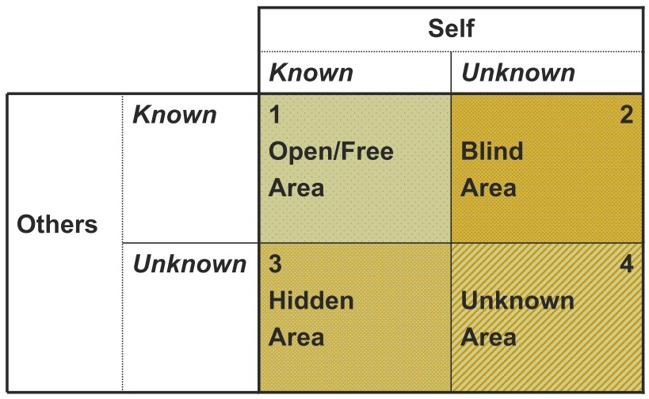
Johari window four quadrants

Slide 12
Johari quadrant 1
Johari region 1 is also known as the 'area of free activity'. This is the information about the person - behaviour, attitude, feelings, emotion, knowledge, experience, skills, views, etc - known by the person ('the self') and known by the group ('others').

Slide 13
Johari quadrant 2
Johari region 2 is what is known about a person by others in
the group, but is unknown by the person him/herself.

Slide 14
Johari quadrant 3
what is known to ourselves but kept hidden from, and therefore unknown to others.

Slide 15
Johari quadrant 4
It contains
information, feelings, talent
abilities, aptitudes, experiences etc, that are unknown to the person him/herself and unknown to others in the group.

Slide 16
Unknown factors
an ability that is under-estimated or un-tried through lack of opportunity, encouragement, confidence or training.
a natural ability or aptitude that a person doesn't realise they possess
a fear or aversion that a person does not know they have
an unknown illness
repressed or subconscious feelings
conditioned behaviour or attitudes from childhood

Slide 17
Drawbacks of Johari window
Some thing are perhaps better not to Communicated (like mental or health problem)
Some people may pass on the information they received
further then we desire.
Some people may react negatively.
Using johari window is useless exercise if it is not linked to the activities that reinforce positive behavior or that correct negative behavior.
Some cultures have a very open and accepting approach to feedback and others do not.
Some people take personal feedback offensively.

Slide 18
References
Townsend MC, Morgan KI. Psychiatric mental health nursing: Concepts of care in evidence-based practice. FA Davis; 2017 Oct 19.
Luft J, Ingham H. The johari window. Human relations training news. 1961 Jan;5(1):6-7.
www.google.com
www.wikipedia.com
www.studymafia.org

Slide 19
Thank You......

