Slide 1
Integrated management of neonatal and childhood illness
Prepared by
Deepa Davis T
Community health Nursing Dept.
JMCON

Slide 2
Objectives
Central objectives
At the end of the class the Students will gain indepth knowledge regarding IMNCI and apply this knowledge in practice with positive attitude

Slide 3
Objectives
Specific Objective
Students will be able to
Define IMNCI
List down Objectives
Explain the Stratergy with components
Describe the Colour code
Enlist the Elements of IMNCI
Explain IMNCI process

Slide 4
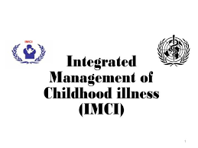

Slide 5
IMCI
IMCI is a strategy for an integrated approach to the management of childhood illness as it is important for child health programmes to look beyond the treatment of a single disease.
It is cost effective and emphasizes prevention of disease and promotion of child health and development besides provision of standard case management of childhood illness.

Slide 6
IMNCI
designed for the management of sick children aged 1 week up to 5 years.
They promote evidence-based assessment and management, using a syndromic approach that supports the rational, effective and affordable use of drugs.
They include methods for assessing signs that indicate severe disease; assessing a child's nutrition, immunization, and feeding; teaching parents how to care for a child at home; counselling parents to solve feeding problems; and advising parents about when to return to a health facility.

Slide 7
CONTD…
sick children present with signs and symptom related to more than one conditions. So we need a combine therapy
In response to these challenge, WHO and UNICEF developed a strategy known as IMCI.
The strategy combines improved management of childhood illness with aspects of nutrition, immunization, and other important disease prevention and health promotion elements

Slide 8
CONTD…
IMCI classifications are action oriented and allow a health care provider to determine if a child should be urgently referred to another health facility, if the child can be treated at the first-level facility (e.g. with oral antibiotic, antimalarial, ORS, etc.) or if the child can be safely managed at home.

Slide 9
objectives
to reduce deaths and the frequency and severity of illness and disability
to contribute to improved growth and development.

Slide 10
The strategy includes three main components
• Improvements in the case-management skills of health staff through the provision of locally adapted guidelines on IMCI and through activities to promote their use.
Improvements in the health system required for effective management of childhood illness.
Improvements in family and community practices.

Slide 11
CONTD…
IMNCI strategy is one of the main intervention under the RCH II/ NRHM
The strategy encompasses a range of interventions to prevent and manage the commonest major childhood diseases.
Pre-service IMNCI
Facility based IMNCI (F-IMNCI)
Facility based newborn care

Slide 12
Case Management Process
The case management process is presented on two different sets of charts : one for children age 2 months up to five years, and one for children age 1 week up to 2 months.

Slide 13
ELEMENTS OF IMNCI
a. Assess
b. Classify
-urgent pre-referral treatment and referral (pink), or
- specific medical treatment and advice (yellow}, or
- simple advice on home management (green).
c. Identify
d.Treatment
e.Counsel
f. Give follow-up care

Slide 14
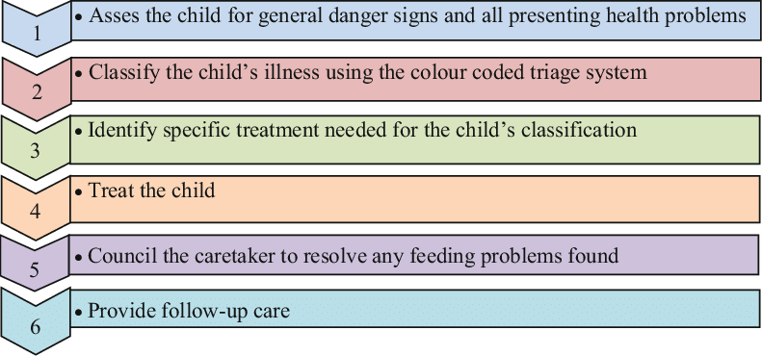

Slide 15
Colour code of IMNCI

Slide 16
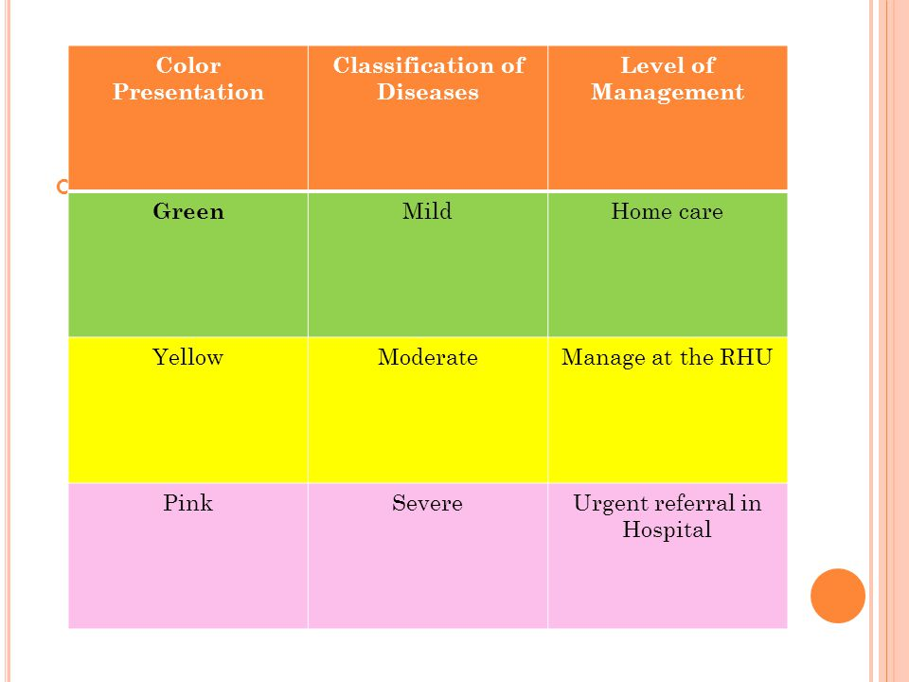
COLOR CODE - IMNCI

Slide 17
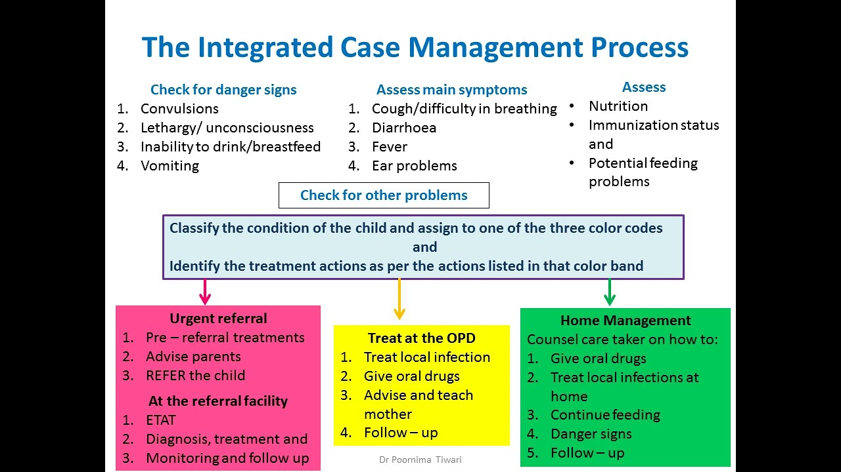

Slide 18
The Indian version of IMCI has been renamed as Integrated Management of Neonatal and Childhood Illness (IMNCI) in 2003
It is the child health interventions under the RCH II strategy.
The major highlights of the Indian adaptation are :
a. Inclusion of 0-7 days age in the programme
b. Incorporating national guidelines on malaria, anaemia, vitamin-A supplementation and immunization schedule
c. Training of the health personnel begins with sick young infants upto 2 months
d. Proportion of training time devoted to sick young infant and sick child is almost equal; and is skill based.

Slide 19
objective
To implement IMNCI package at the level of household, and through ANMs at sub-centre level; through medical officers, nurse and LHVs at PHCs level

Slide 20
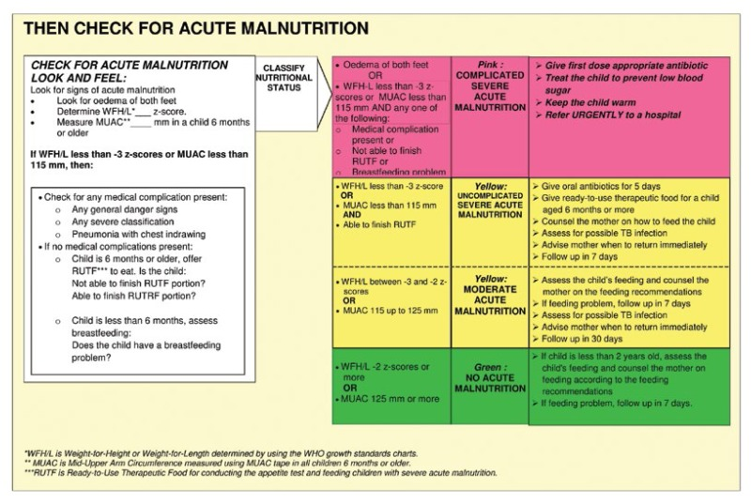

Slide 21
REFERENCE
1. Park k, Textbook of community medicine,25 ^{th}ed, bhanot publishers,2020
2.Gullani KK,Community Health Nursing,2nded, kumar publishers,2012
3 .Kadri AM, Text book of Community Medicine,1STed,jaypee publishers,2019

Slide 22


